Slide 1
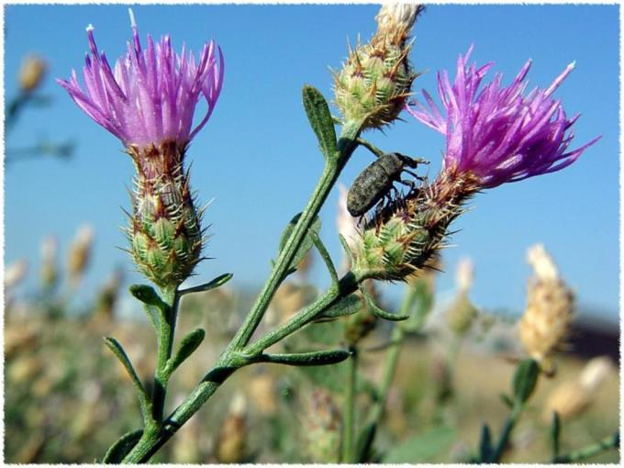
Bureau of Land Management Invasive Species Program

Slide 2
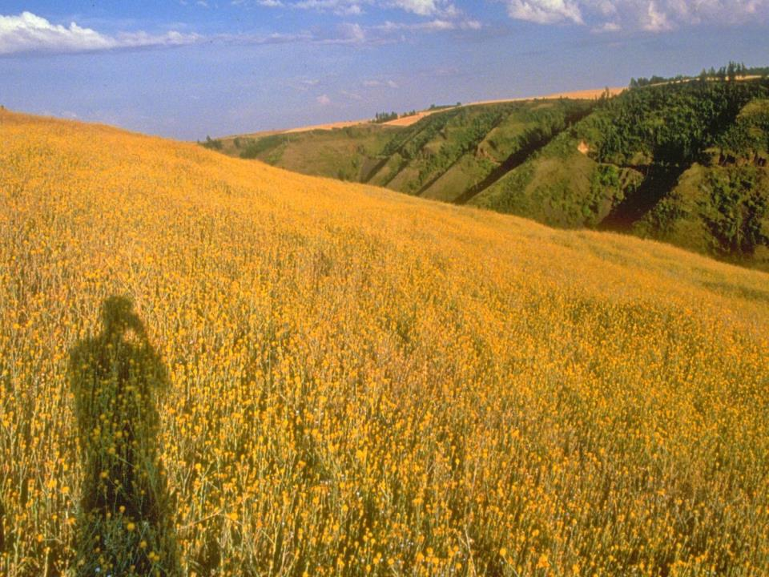
Notes:
Landscape can dramatically be altered by large infestations. Society, in general, has not accepted habitats infested by weeds will change and we will have to adapt.

Slide 3
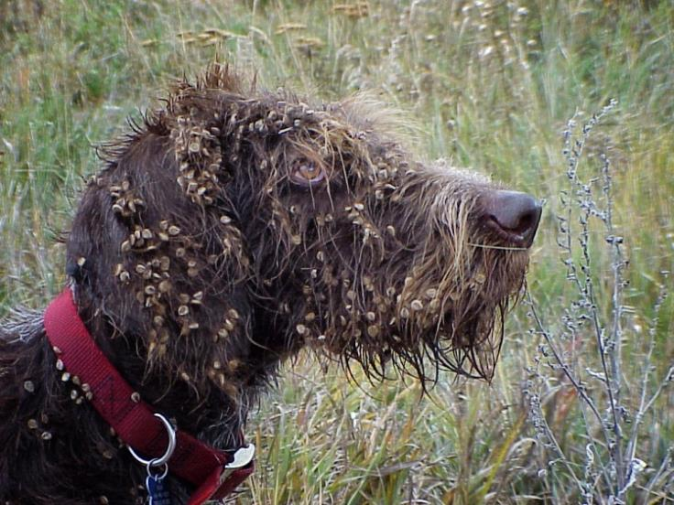
Notes:
Invasive plants may not always be a concern to individuals UNTIL it becomes a personal problem.

Slide 4
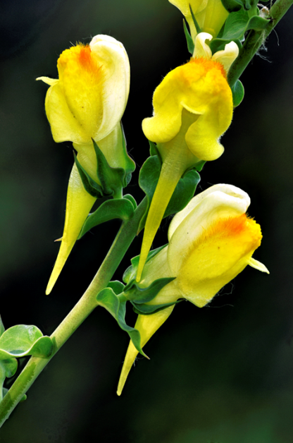
“But it’s only a
few plants.”

Slide 5
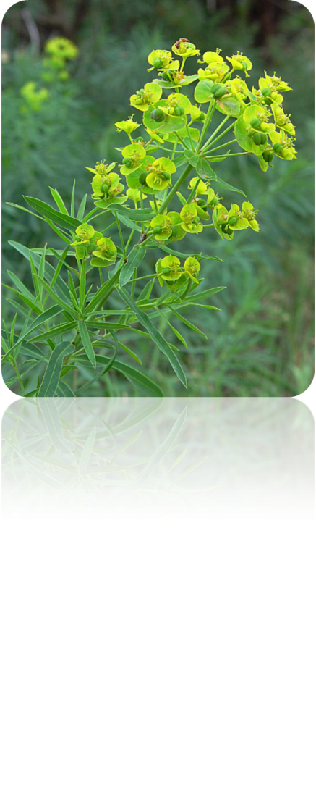
Notes:
Leafy spurge

Slide 6
Notes:
Map courtesy of Fremont County

Slide 7
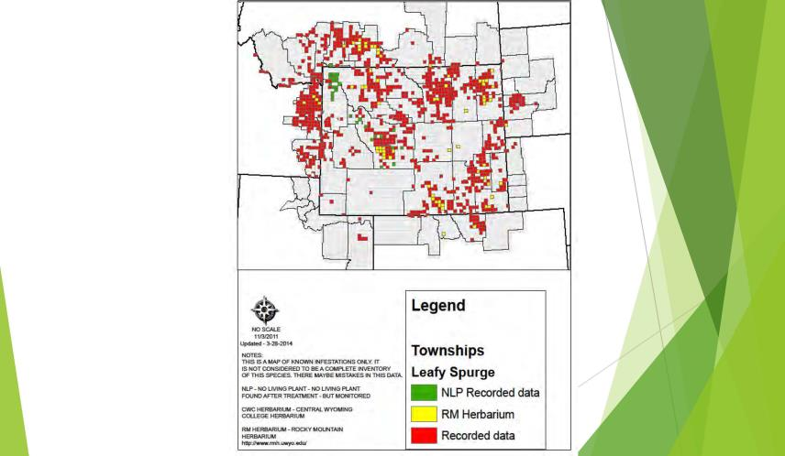

Slide 8
Management Question
What weed populations should be treated?
Just large populations?
Certain species?
Weeds threatening agriculture?
Weeds threatening “specific” areas or species

Slide 9
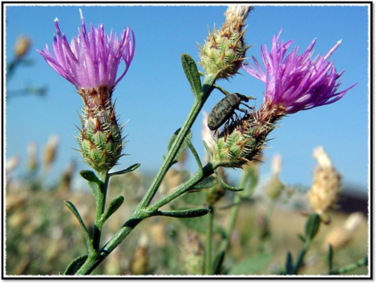
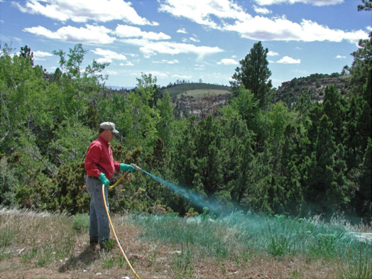
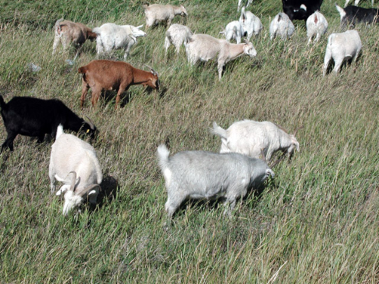
Control
Integrated Pest Management
Notes:
During the preparation of

Slide 10
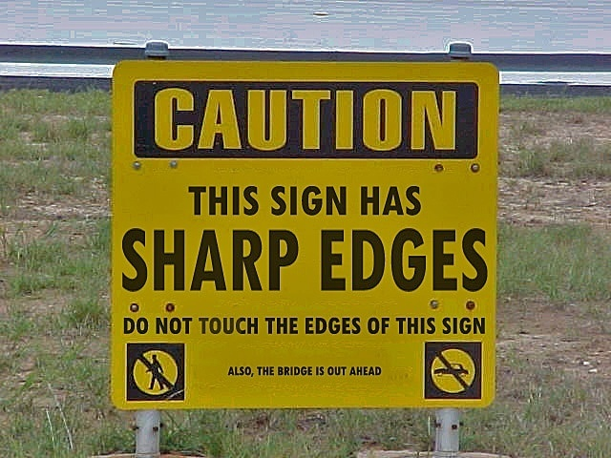
Notes:
Like this sign where the real message is not readily seen, most of the BLM process and decision making for weed control is not readily known by most folks.

Slide 11
The Process
Federal Land Policy & Management Act
Land Use Plan
VEG EIS
Veg.Treatment
Field Office EA
Weed Man. Plan
PUP
PAR
Notes:
Federal Land Policy and Management Act (FLPMA) of 1976 - directs the BLM to “take any action necessary to prevent unnecessary and/or undue degradation of the public lands”.
Vegetation EIS – (aminopyralid, fluroxypyr, and rimsulfuron) The BLM has initially identified the following issues for analysis in this programmatic EIS: Effects of herbicides and inert ingredients used in herbicide formulations on human, vegetation, fish and wildlife, livestock, and wild horse and burro health; water quality; Native American resources and resource use; and the cumulative use of these and other herbicides by the BLM and other landowners in the Western U.S.
The Veg EIS identifies the particular herbicide active ingredients that will be allowed to be used on BLM-adminstered lands.
Field Office EA – Typically is drafted for all weed control activities field office wide.

Slide 12
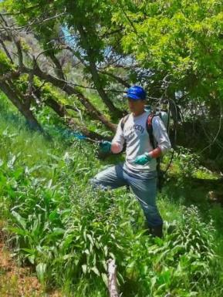
Cooperative Agreements
Provides financial assistance
to a non-Federal partner
Both parties are substantially
involved
Funding carries over fiscal years
Notes:
Wyoming BLM does not have any employees that are full time weed&pest coordinators. Thus, we heavily rely on the county weed&pest personnel.
Financial assistance in which the agency is supporting a non-federal cooperator with funds or items of value and has substantial involvement in the project being funded. The agency is substantially involved when it acts as a partner with the cooperator.

Slide 13
An ounce of prevention is
worth a pound of cure
- Benjamin Franklin
An ounce of prevention is
cheaper than pounds of herbicide
- Ken Henke

Slide 15
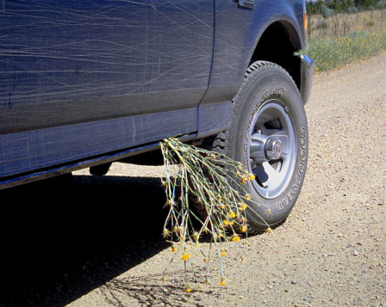
No Free Rides
Use certified hay, mulch, and gravel
Purchase weed
free seed
Clean equipment
Notes:
Zero tolerance of Wyoming “prohibited” weed list. Other weeds have a 2% tolerance by weight.
163,300 cheatgrass seeds in a 50-pound bag of seed!
40,800 cheatgrass seeds per 50-pound bag (0.5% “other” weed seeds – BLM Requirement)

Slide 16
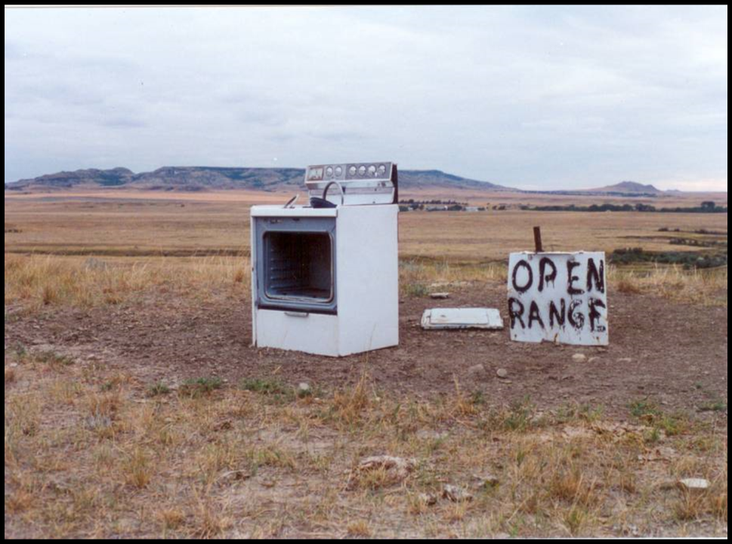
Restore the Range !

Slide 17
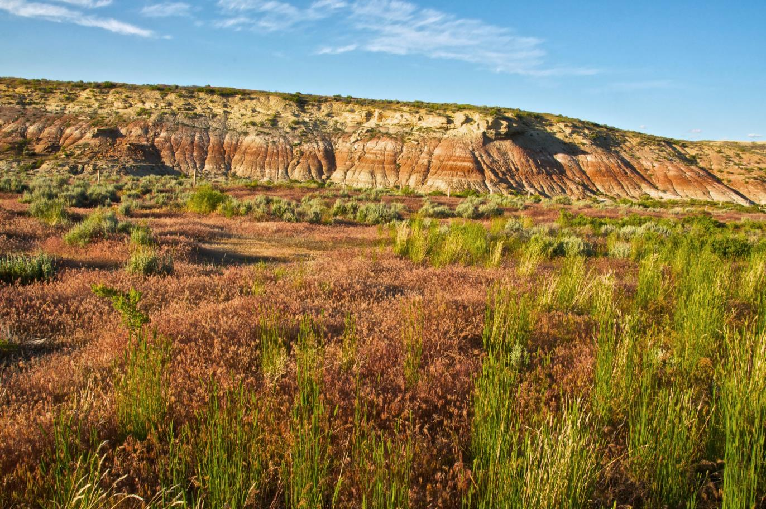

Slide 18
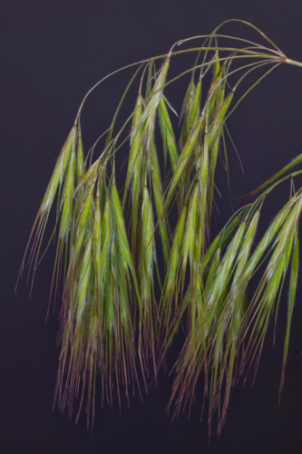
61, 529 acres treated
14,094 acres of Cheatgrass treated

Slide 19
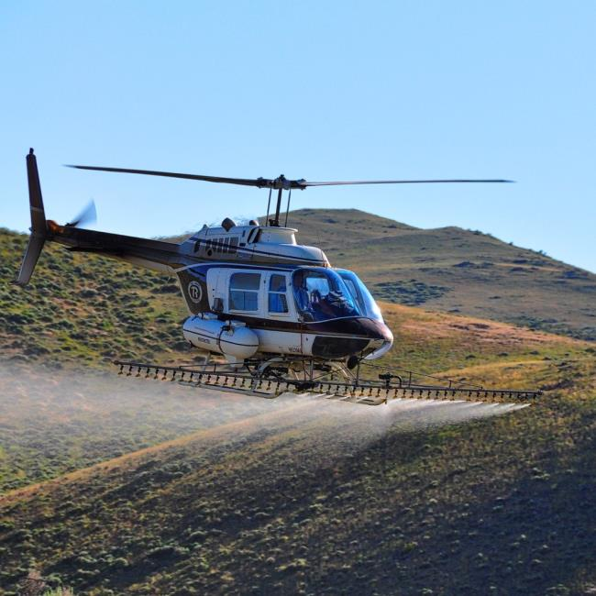
Notes:
Currently broad scale treatments involve aerial application of imazapic

Slide 20
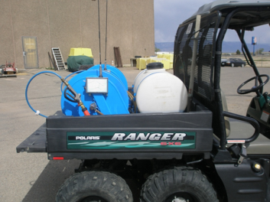
The National Invasive Species Information Management System (NISIMS)
Entering Chemical and Non-chemical Treatment
Survey/Monitoring Data

Slide 21
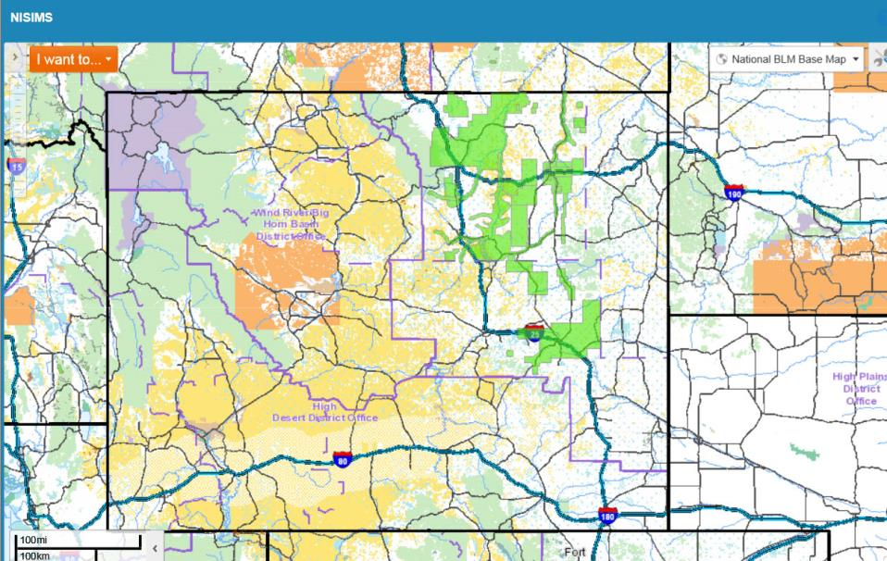
Web-based Application

Slide 22
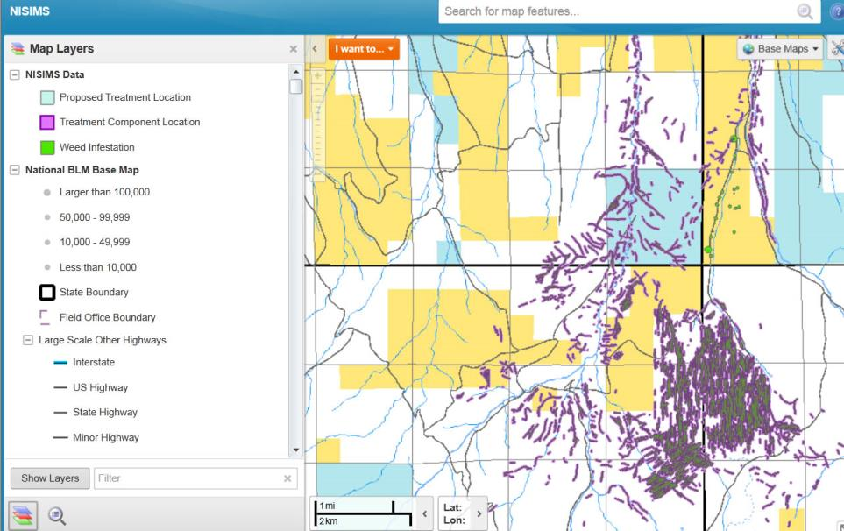

Slide 23
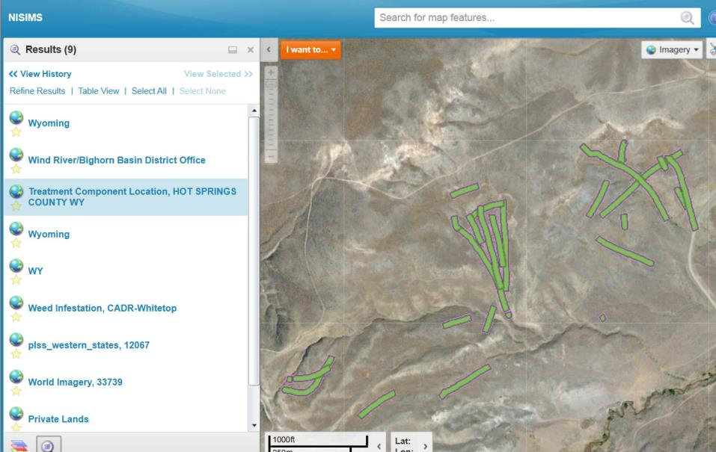

Slide 24
