Slide 1
Weed Management Opportunities and Threats
Brian A. Mealor
University of Wyoming
Sheridan Research and Extension Center
Department of Plant Sciences

Slide 2
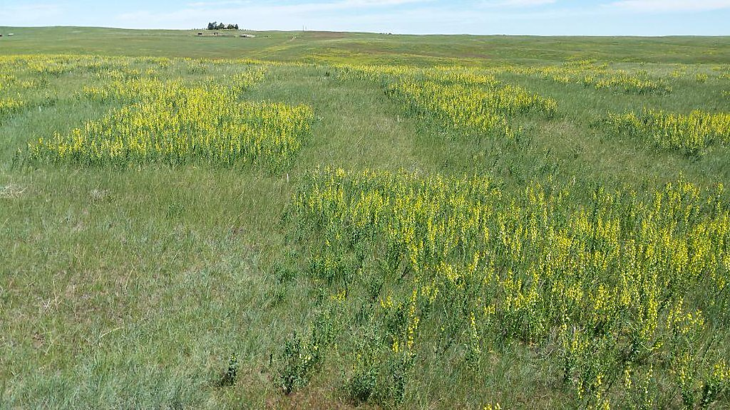

Slide 3
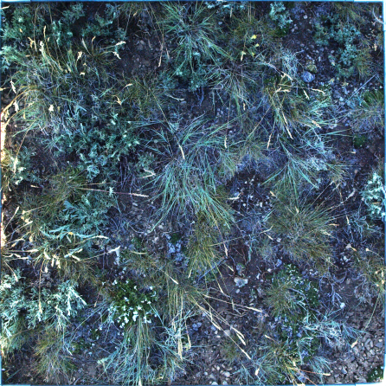
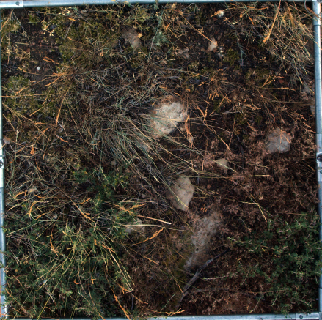
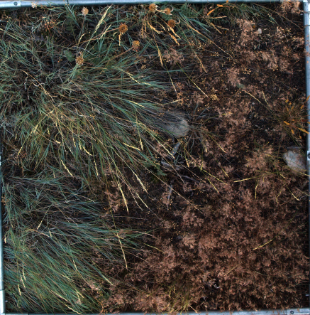
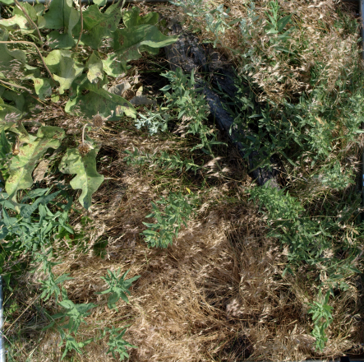
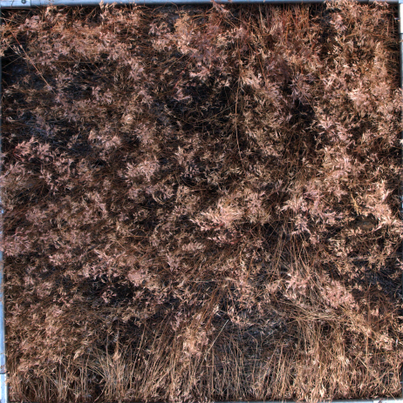
AGGRESSIVE MANAGEMENT?
Maintenance / prevention
Eradication of source populations
Long-term management
Restoration / Abandonment
Notes:
An ecological threshold is crossed when the nature of the system changes – it is driven by another set of mutually reinforcing attributes.
How do we identify thresholds? Where should we prioritize our efforts for control?

Slide 5
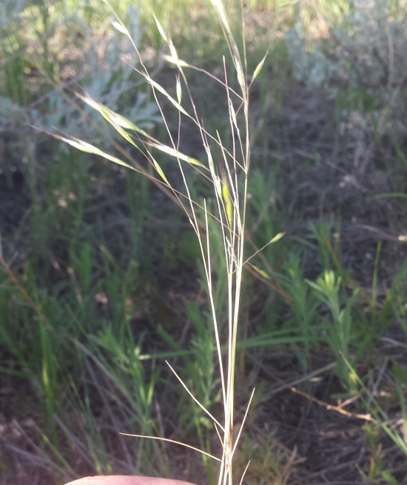
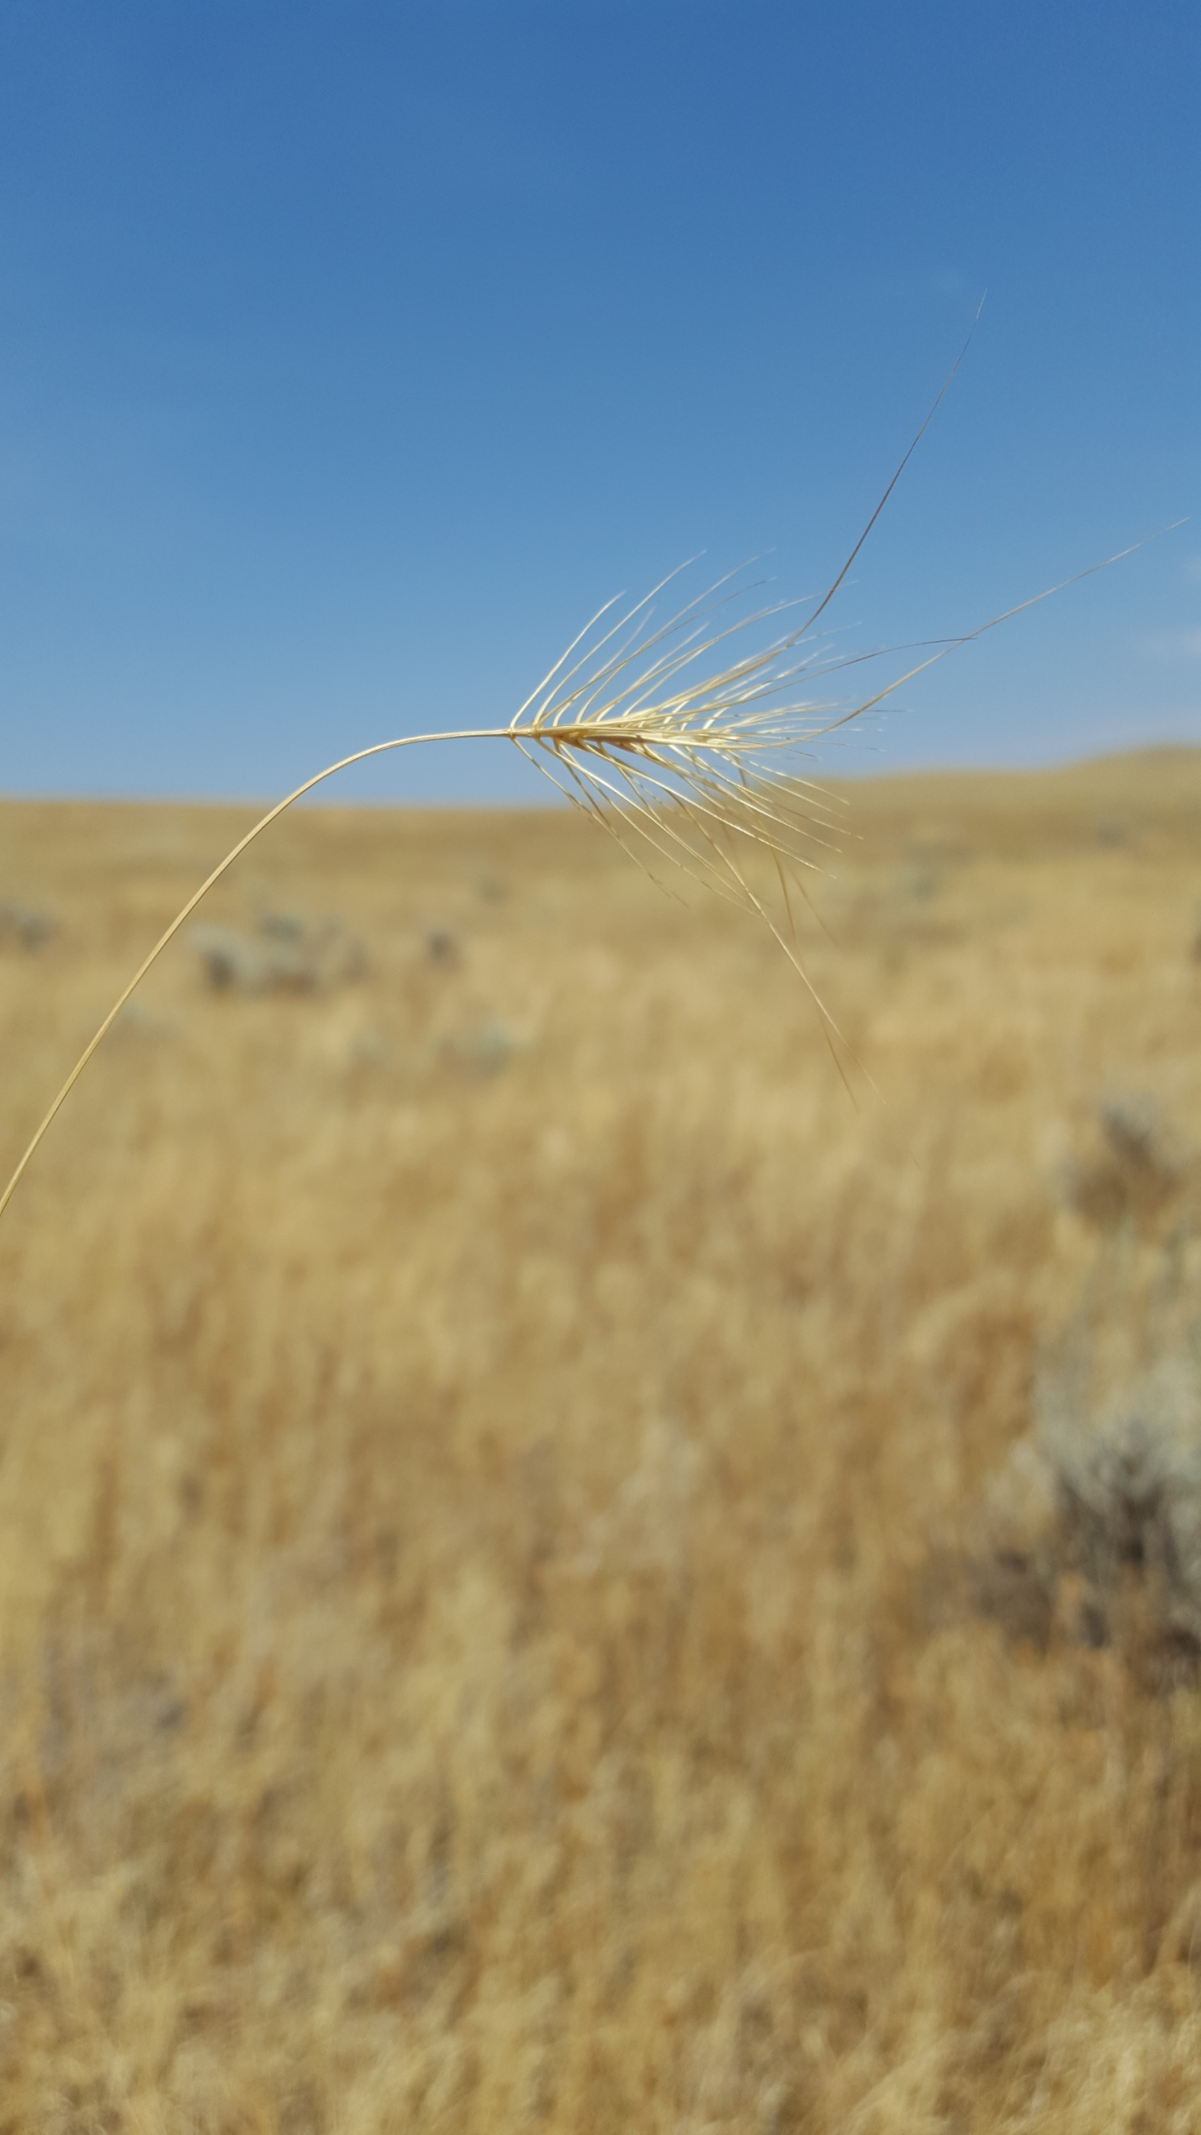

Slide 6
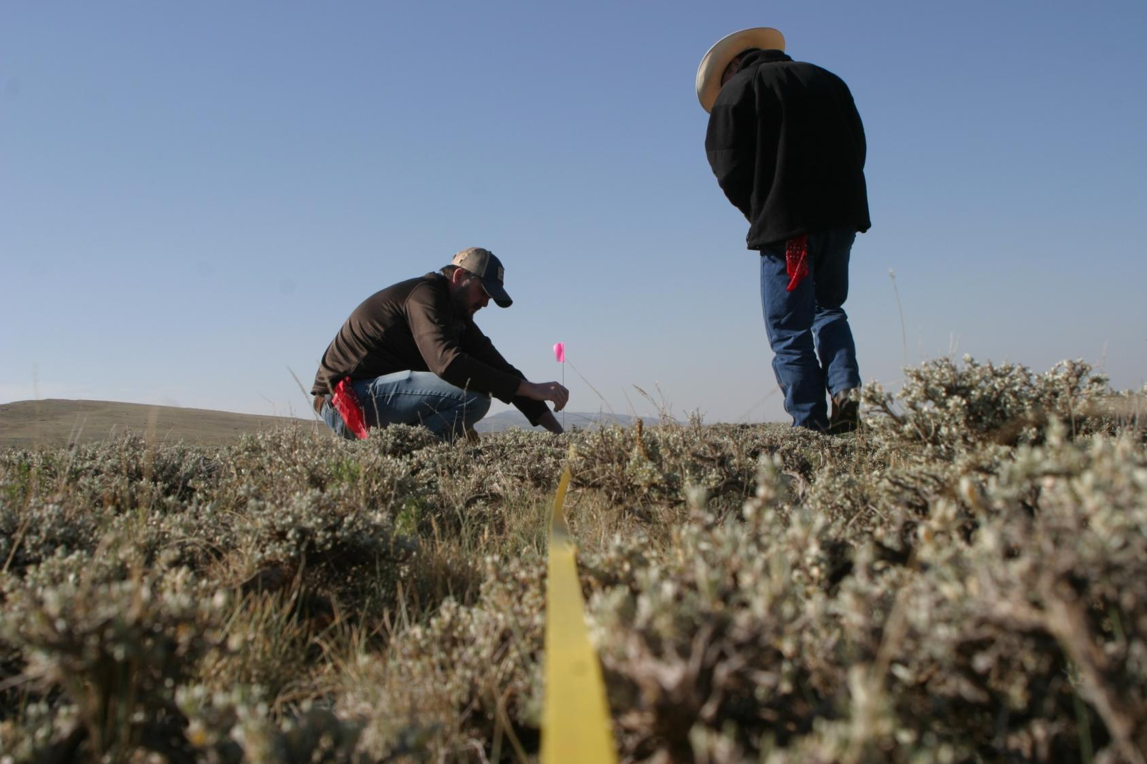

Slide 7
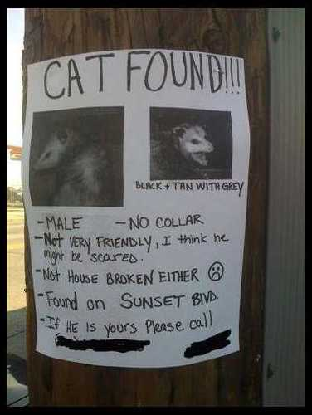

Slide 8
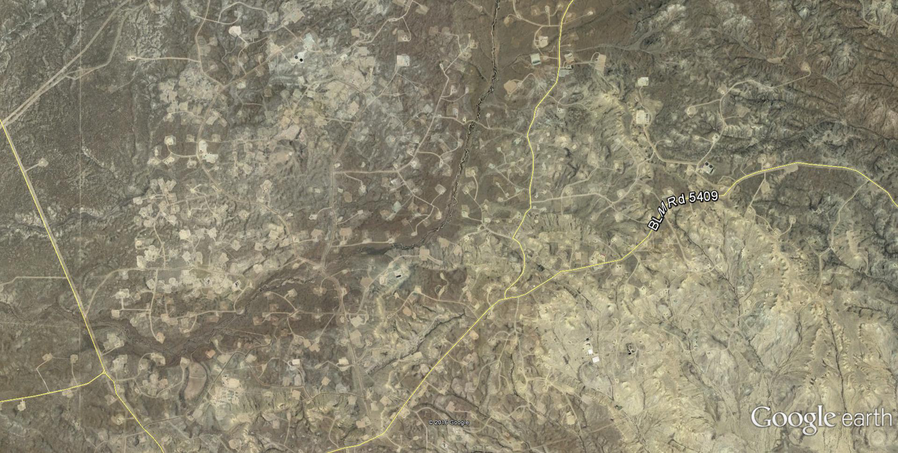

Slide 9
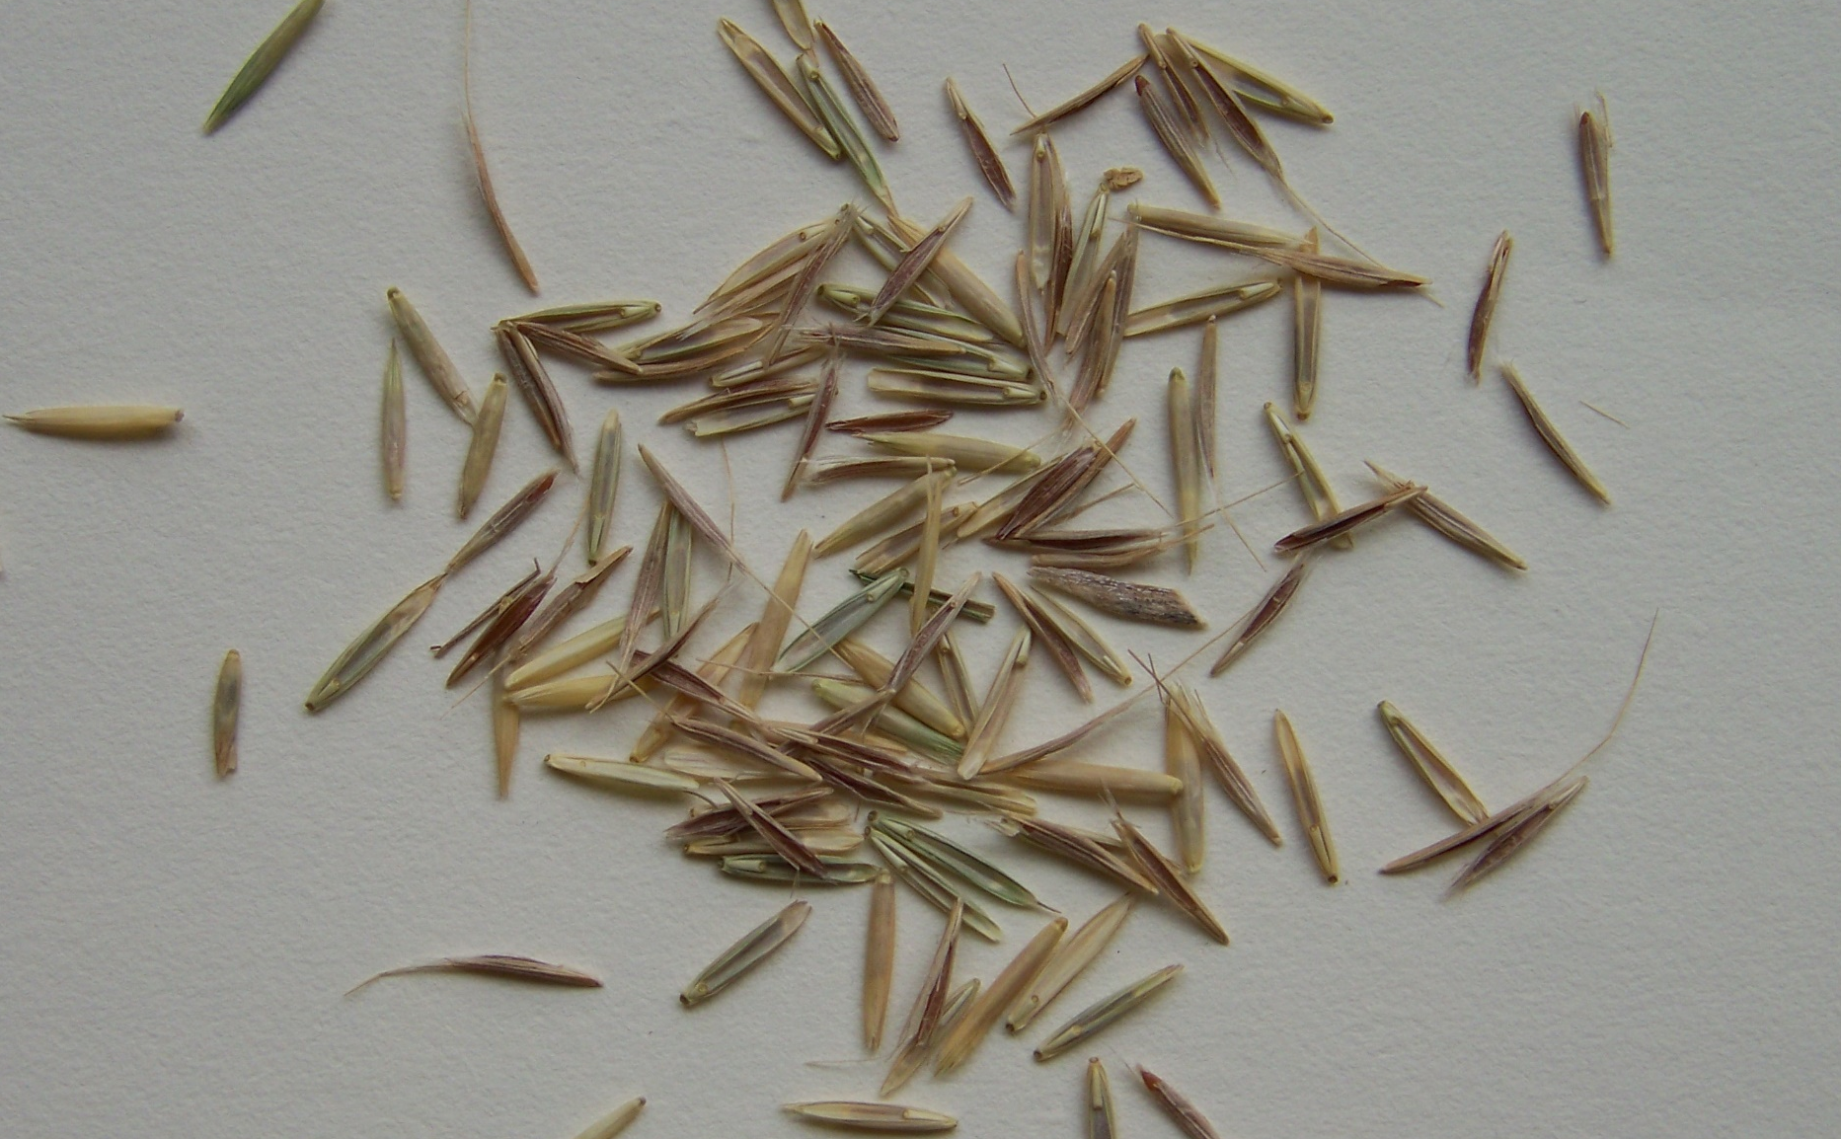

Slide 10
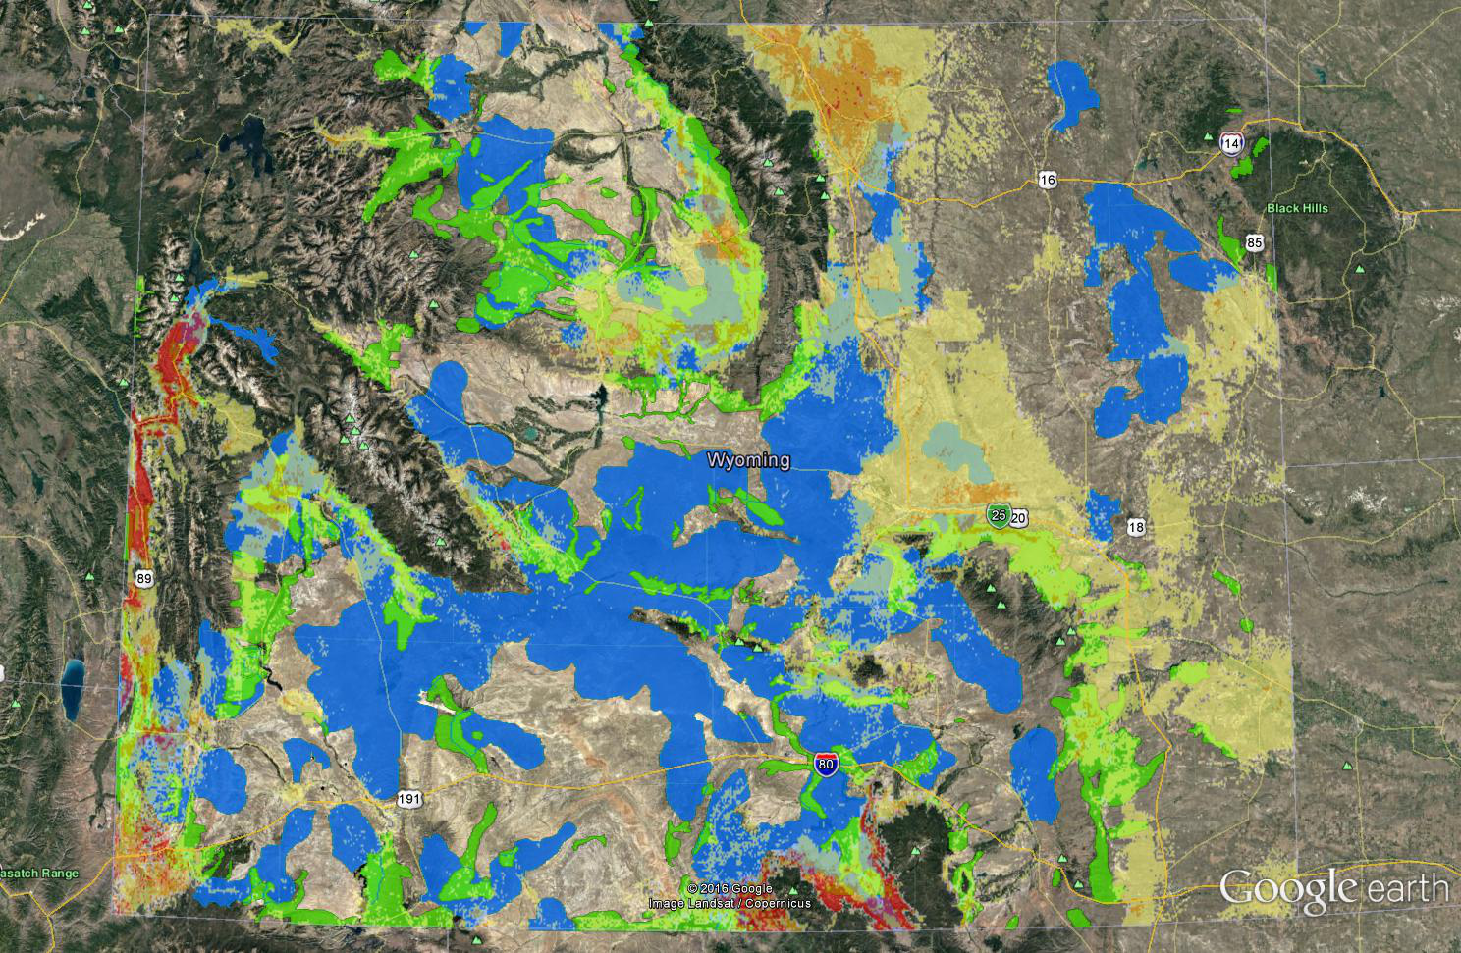

Slide 11
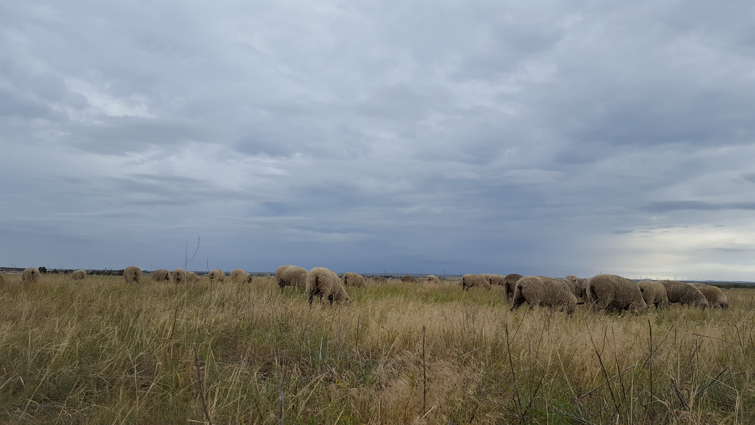
Thank you for your attention!

