Slide 1
Sweetwater Co Weed and Pest
Gale Lamb, Supervisor
Mckinnon, Wy
42 years Experience
Dan Madsen, CCA, Supervisor
Farson, Wy
20 years Experience

Slide 2
What Works
And
What Does Not
Notes:
We have been asked to present some principle of weed management that have been effective within sweetwater county. The absence of these principles have lead to ineffective weed control or a failed project.

Slide 3
Weed Management Plans 101
Weed Ecology: Environmental Interactions
1
Assessment and Monitoring for Weed Management
2
Weed Management
3
Notes:
Weed management begins with the end in mind. Establishing a desired objective for a specific site and then setting goals to reach that objective. The following 3 areas of emphasis are helpful in this process.

Slide 4
Weed Ecology
Study of interactions of weeds with their environment
Study of adaptive mechanisms that enable weeds to persist and proliferate
Notes:
Broadly defined as …. ( 1st bullet point)
More practically understood as…. ( 2nd bullet point)

Slide 5
Adaptive Mechanisms
2 Main types of Adaptation
Phenotypic Adaptation
Altering the outward appearance as a result of environmental influences
Local Adaptation
differences in plant characteristics and domination in different habitats among populations
Examples
Canada Thistle – Changing its growth habits as a result of mowing.
Salt Cedar – Uptake and displacement of salts
Notes:
These are 2 areas of adaptation to help us understand weed ecology in a general way. Each invasive species has it’s own adaptive mechanisms that allow it to persist and proliferate in its environment. Our responsibility and due diligence is to learn the adaptive characteristics for each invasive species we are striving to control. This places us in a position of proactive management not reactive control.

Slide 6
“Weedy environments are often, but not always, heavily impacted by human activities”
Agricultural fields
Livestock grazing
Rights of Way
Recreational areas
Energy Development
Focus of Weed Management Plans
Minimize disturbances that provide a selective advantage for weeds.
Goal to accomplish
Diversify the type and timing of disturbance as to not consistently select for a particular weed species
Notes:
Understanding why an environment is weedy will aid our efforts in breaking the weedy cycle and implementing management efforts. All too often a weedy environment is a cause of human activities.
The focus of a weed management plan is to minimize disturbances that provide a selective advantage for weeds.
A goal to help accomplish that plan is to diversity.
Examples of minimizing, avoiding recreational blading of backslopes, overgrazing pastures,
Examples of diversifying , changing time of season that barrow pit and road shoulders are bladed for control of black henbane.
Understanding how a weed persists in an environment helps us know how to break its weedy cycle

Slide 7
Assessment and Monitoring for Weed Management
“ You can’t manage what you don’t measure”
- anonymous
Notes:
This is a quote That I have found to hold great value. Understanding the dynamics of a plant community helps avoid miss management. This stage of the weed management plan helps us understand the current condition of the site and the direction of we need to go to achieve our site goals

Slide 8
Assessment and Monitoring for Weed Management
Assessment
Site Condition at that point in time
Plant communities
Primary and Secondary
Diversity ( Mono-culture)
Understory growth
Monitoring
Orderly collection, analysis, and interpretation of resource data to evaluate progress toward management objectives
Long term
Notes:
Assessment allows a manager to understand the dynamics of a plant community at a specific point in time.
Monitoring over time allows a manager to analysis progress towards management objectives including weed treatments and environmental changes to plant communities

Slide 9
Data Collection Strategies
Survey :
Sampling and data collecting over large areas of a management unit
Inventory :
Cataloguing of an entire management area. Due to expense it is common to inventory small units.
Monitoring :
Collection and analysis over time.
Weed pressure, population, treatments and treatment area, and impacts of management practices
Weed Mapping :
Describes many activities where spatial data of weed populations is gathered and analyzed.
A weed map is then created to identify a varying vegetation across a landscape.

Slide 10
Areas of Emphasis for Weed Mapping
Presence/Absence : What is there, what is not
Estimation of population size
Image-based Techniques:
Photopoint – Photograph from a permanent reference point
Photoplot – Close photo of a defined area
Density estimation
Vegetation Cover ( weed species and beneficial plant species)
Basal cover
Canopy cover
Notes:
Each of these allow use to gather information that aid in our approach to weed and site management. Our approach to weed mapping combines aspects from each of the data collection strategies.
Apps like grassSnap is an effective way to implement a photopoint technique.

Slide 11
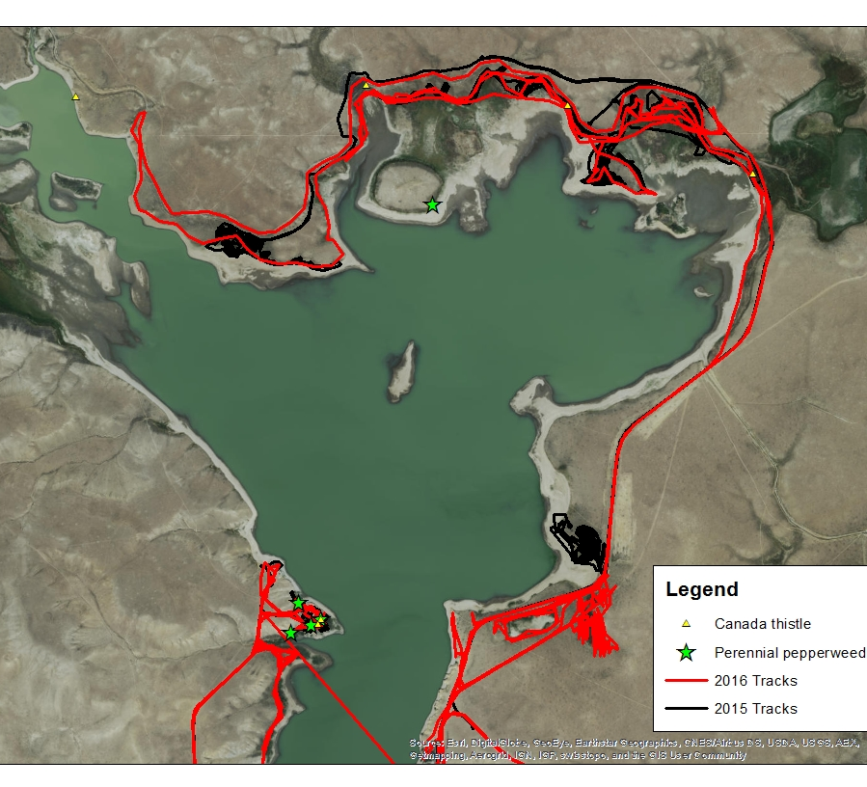
Eden Valley Reservoir
Notes:
Initial weed mapping took place in 2014. An inventory was taken as to plant communities and weed infestations within those communities. An understory of benefical grasses was observed within the weedy infestations of CT and PP
Applications were made in 2015 and 2016 with each application the weed infestation was reduced and the beneficial grasses were increased as a result of reduced competition

Slide 12
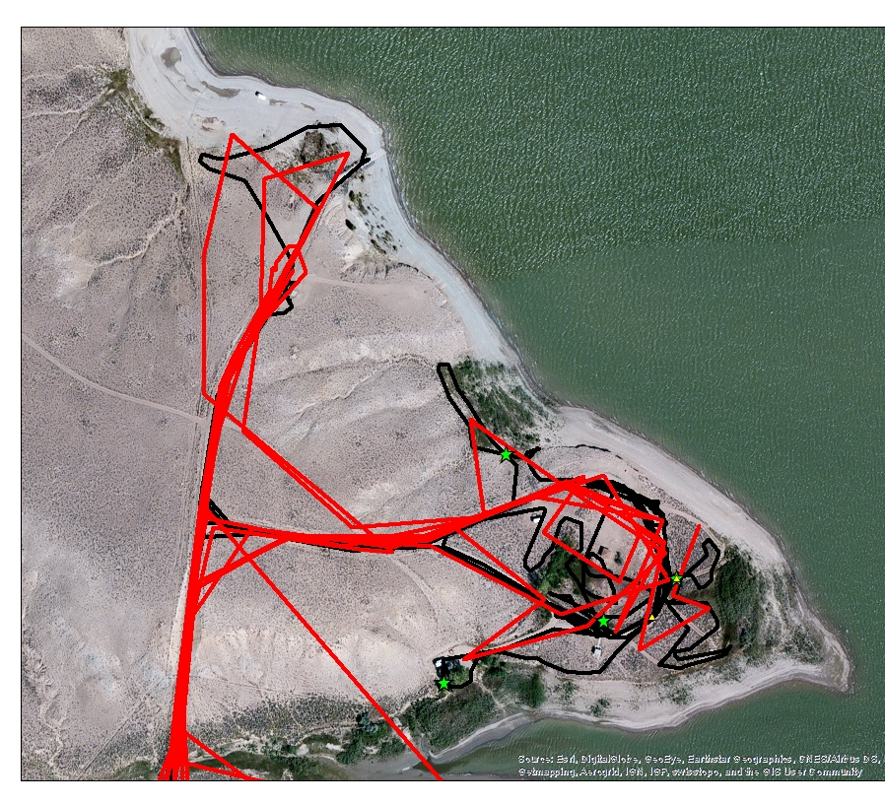
Eden Valley Reservoir
Notes:
Additional coverage is performed to ensure that all infestations are treated.

Slide 13
Weed Management
Most weed control practices can be divided into 4 categories:
Physical: Mechanical & Non Mechanical ( intensive grazing, hand-pulling, fire, mulches, chaining, etc.)
Cultural: Introduce or encourage competitive species, seeding rates & timing, Row Spacing. Habitat management.
Chemical: Herbicides
Biological: Use of natural enemies to reduce plant populations ( diorhabda sublineata on salt cedar)
“Toolbox” analogy to Weed Management
Notes:
A weed management program is most successful when tools from each category is used as a means to achieve a sites objectives.

Slide 14
“ An ounce of prevention is worth a pound of cure”
Weed free seed, hay, soil, compost (start clean, stay clean )
Isolation of imported animals for a period of time
Cleaning equipment before transportation
Preventing seed production or vegetative reproduction of new infestations
Scouting for new infestations ( Early Detection)
Leafy Spurge on Seedskadee
Spot treatments of new infestations (Rapid Response)
Preventing the degradation of desirable species
Weed education efforts ( especially identification)

Slide 15
Sugar Loaf Basin – Flaming Gorge Released June 23rd 2011

Slide 16
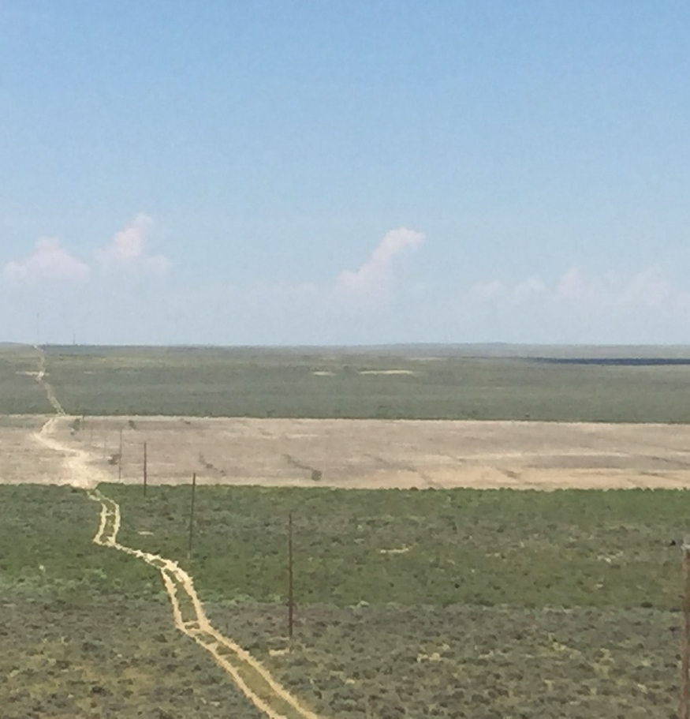
Bone Draw 2014 & 2015

Slide 17
Bone Draw 2016

Slide 18
“It is the little things that make the Big things possible”
J Willard Marriott

