Slide 1
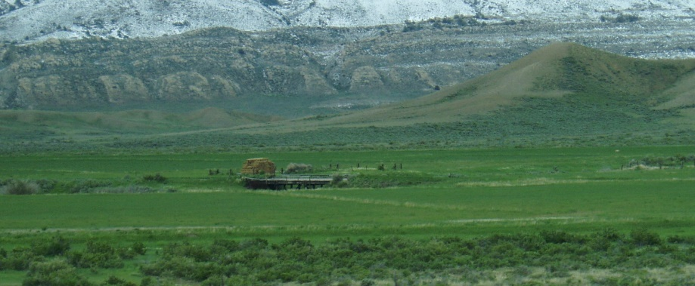
Invasive Plant Species
Challenges & Opportunities
April 25, 2017

Slide 2
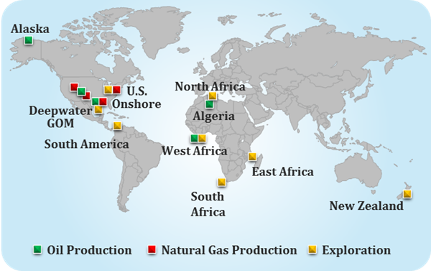
Anadarko Petroleum Corporation
One of the World’s Largest Independent Oil and Natural Gas Exploration and Production Companies
Produces Enough Energy to Meet
Daily Demands of ~25 Million Avg. American Homes.
Wyoming’s largest landowner (land grant).

Slide 3
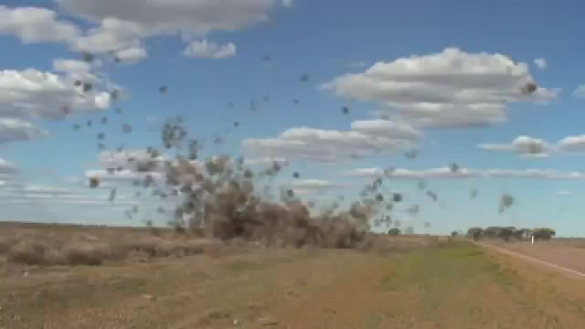
Invasive Species Can Create A Whirlwind Of Challenges!

Slide 4
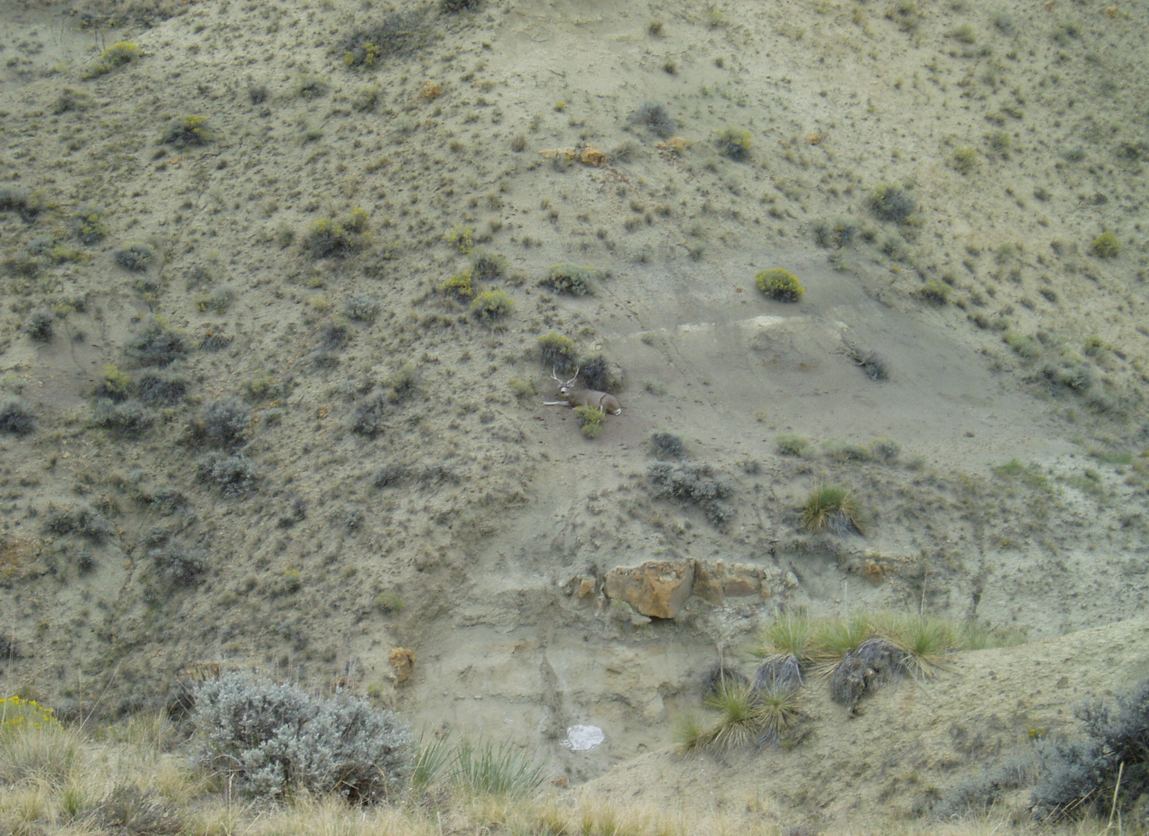
Begin With the End in Mind
Notes:
Reclamation and weed management start long before any disturbance. This shows a

Slide 5
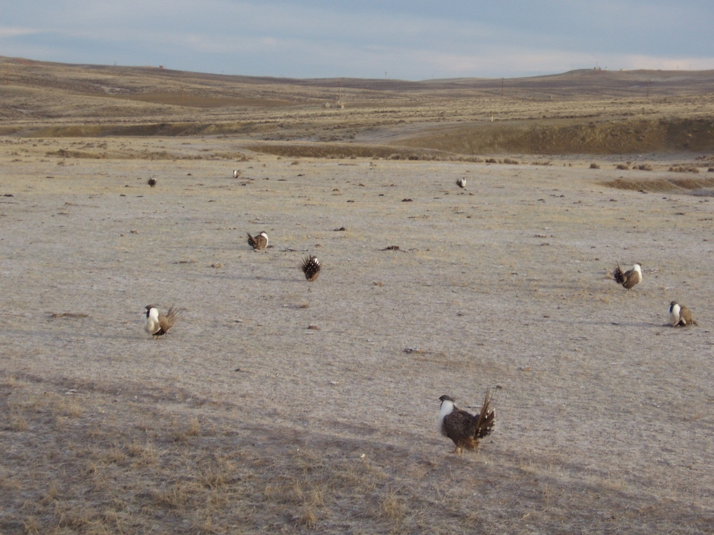
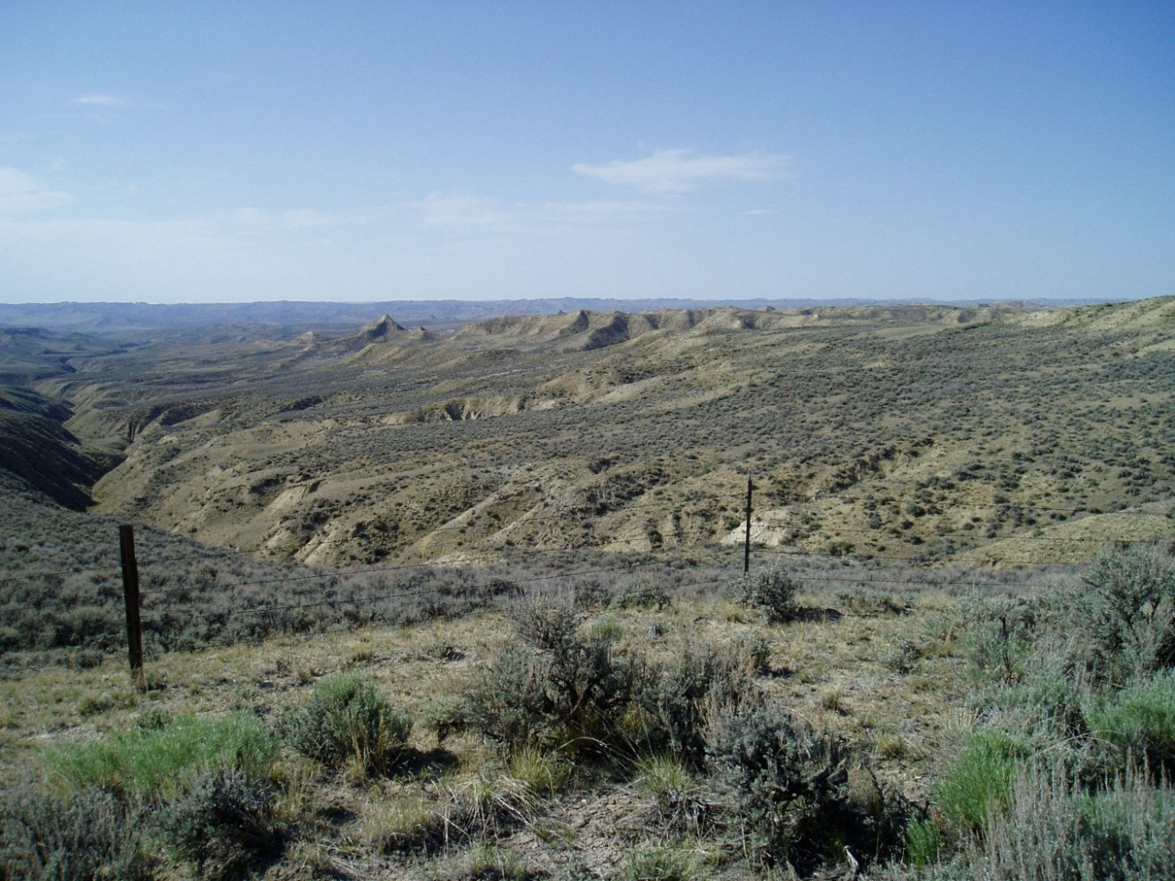
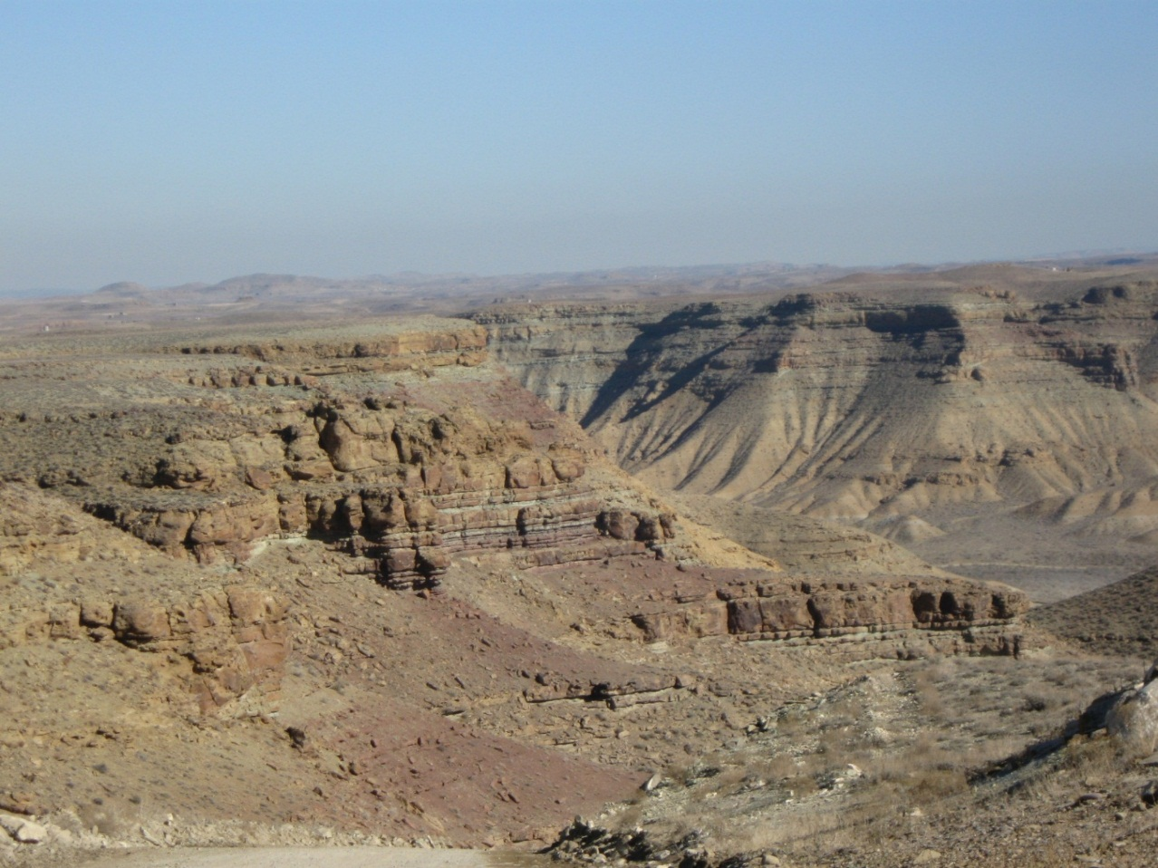
Each Location is Unique!
Notes:
From topography to wildlife – each site is treated on an individual basis – there are many more factors than just topography/reclamation & wildlife that goes into the decision to drill a well or place a pipeline or facility.

Slide 6
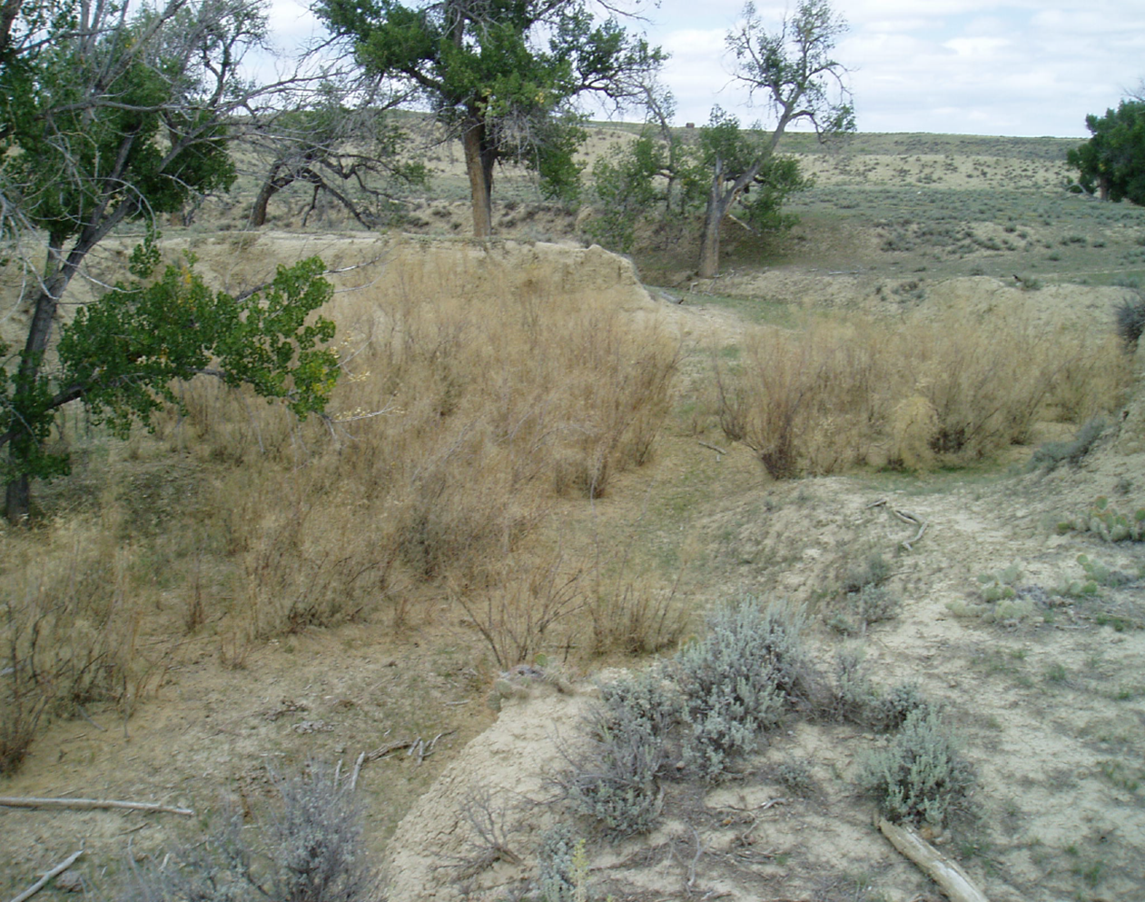
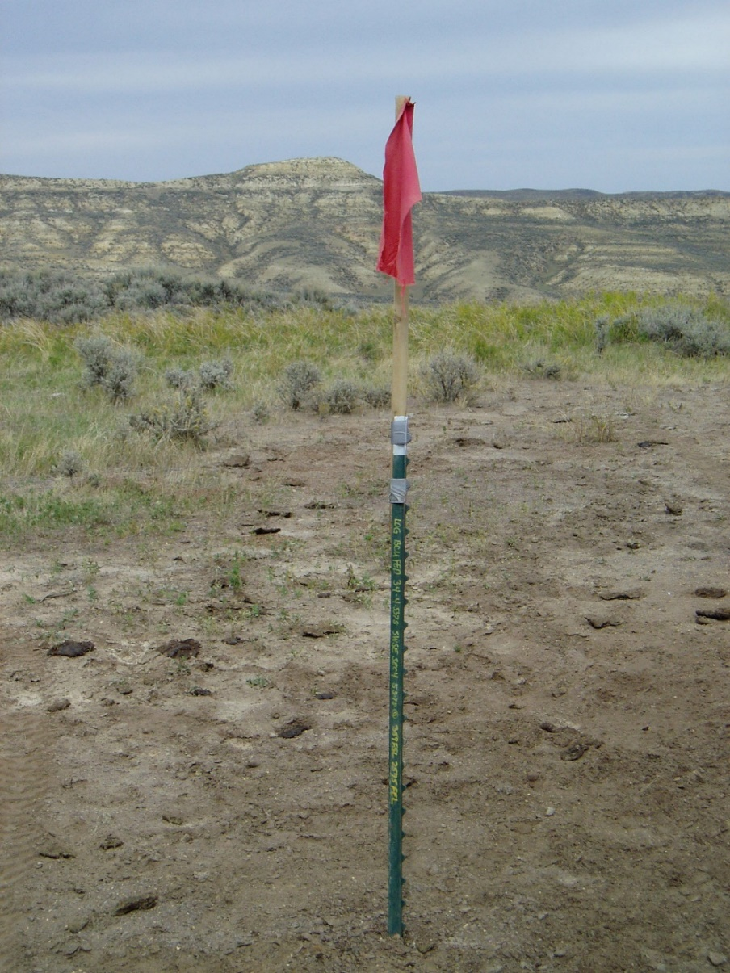
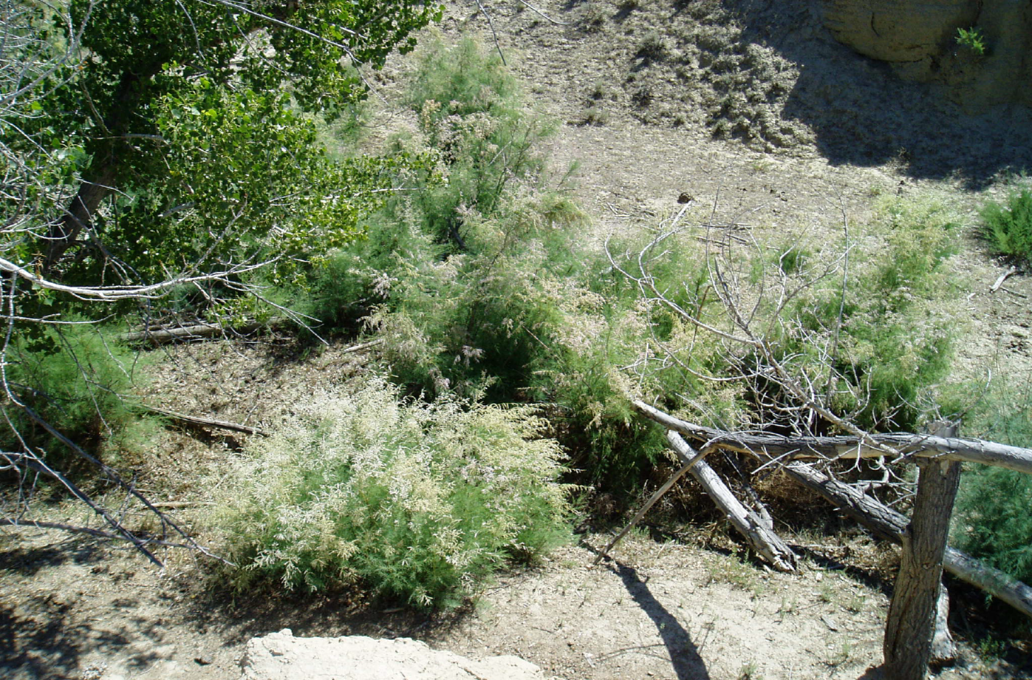
An Ounce of Prevention is Worth a Pound of Cure
Notes:
We identify issues early on in the development process. If we can’t avoid them we address them early.

Slide 7
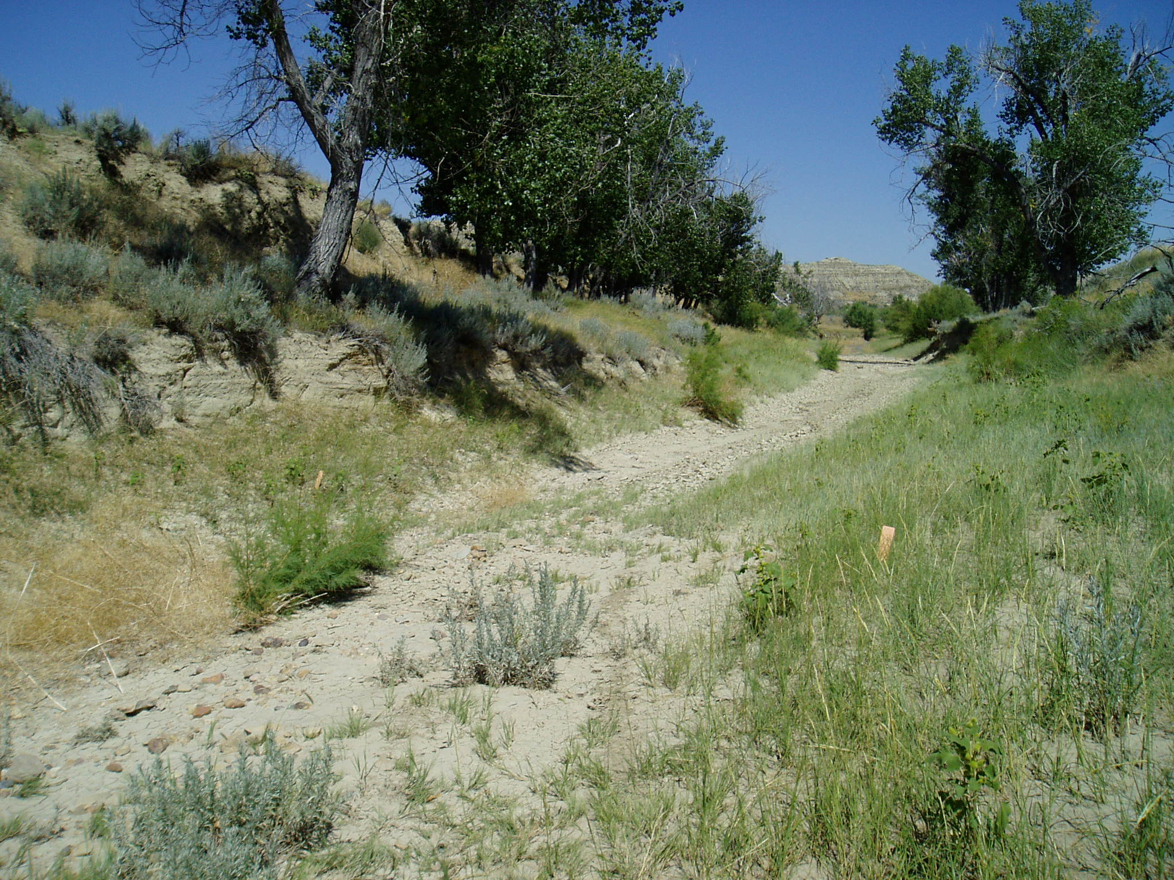
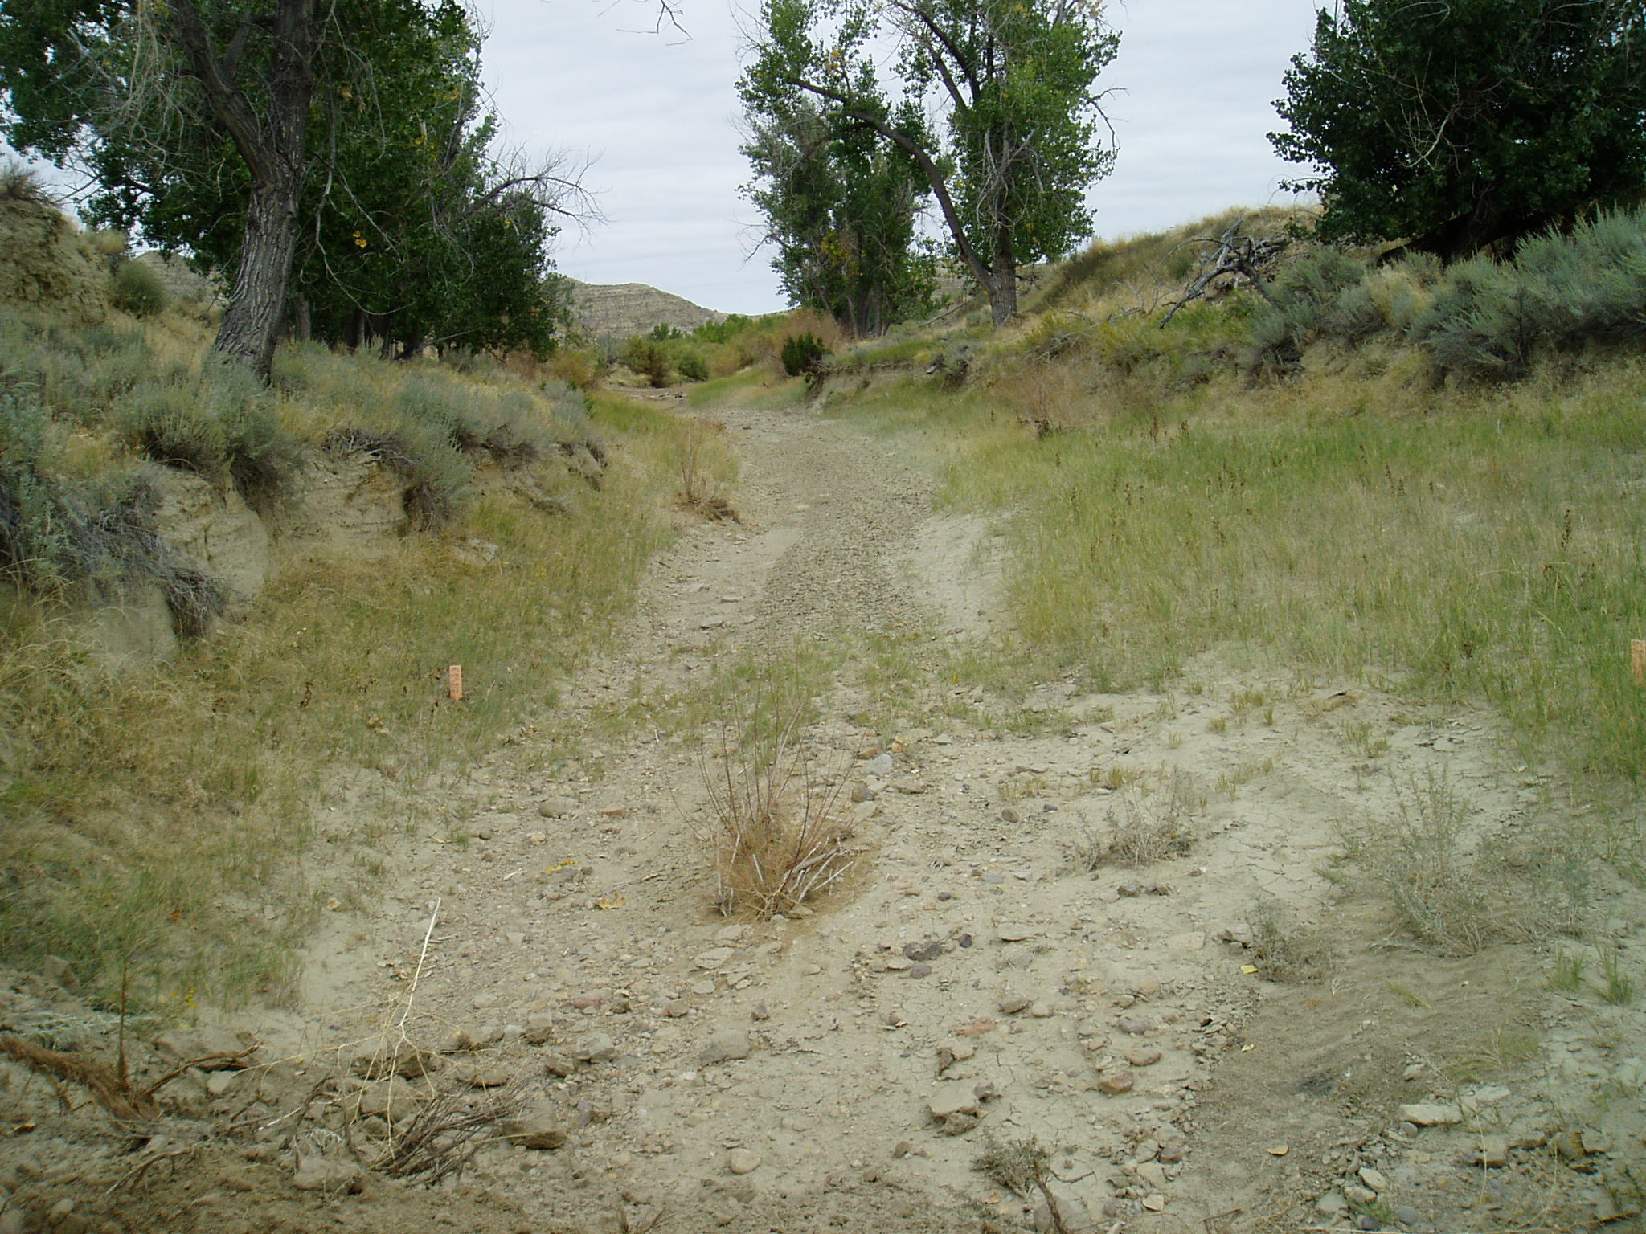
Proactive Approaches to Invasive Species Control

Slide 8
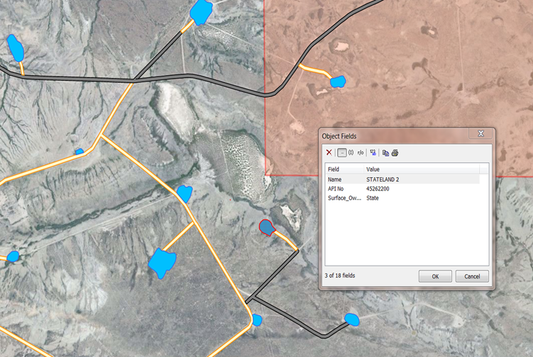
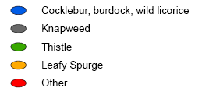
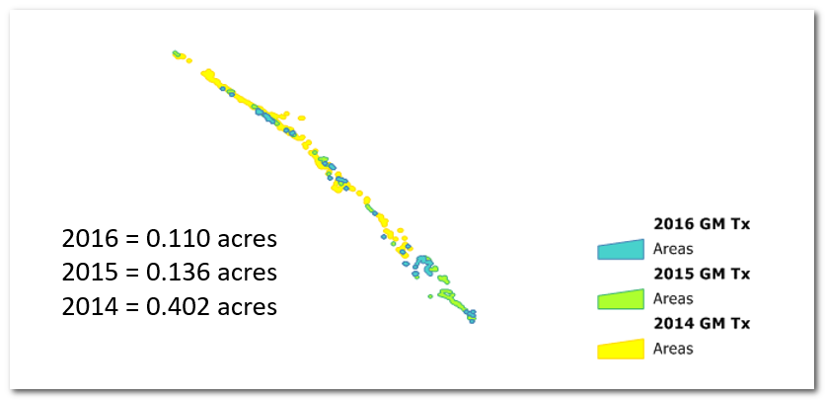
Use of GIS Data
Notes:
Use of GIS weed information is very helpful in our planning stages.

Slide 9
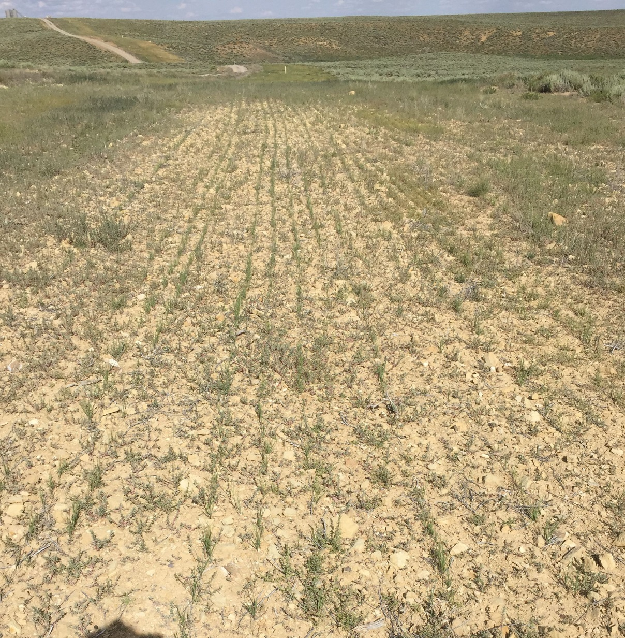
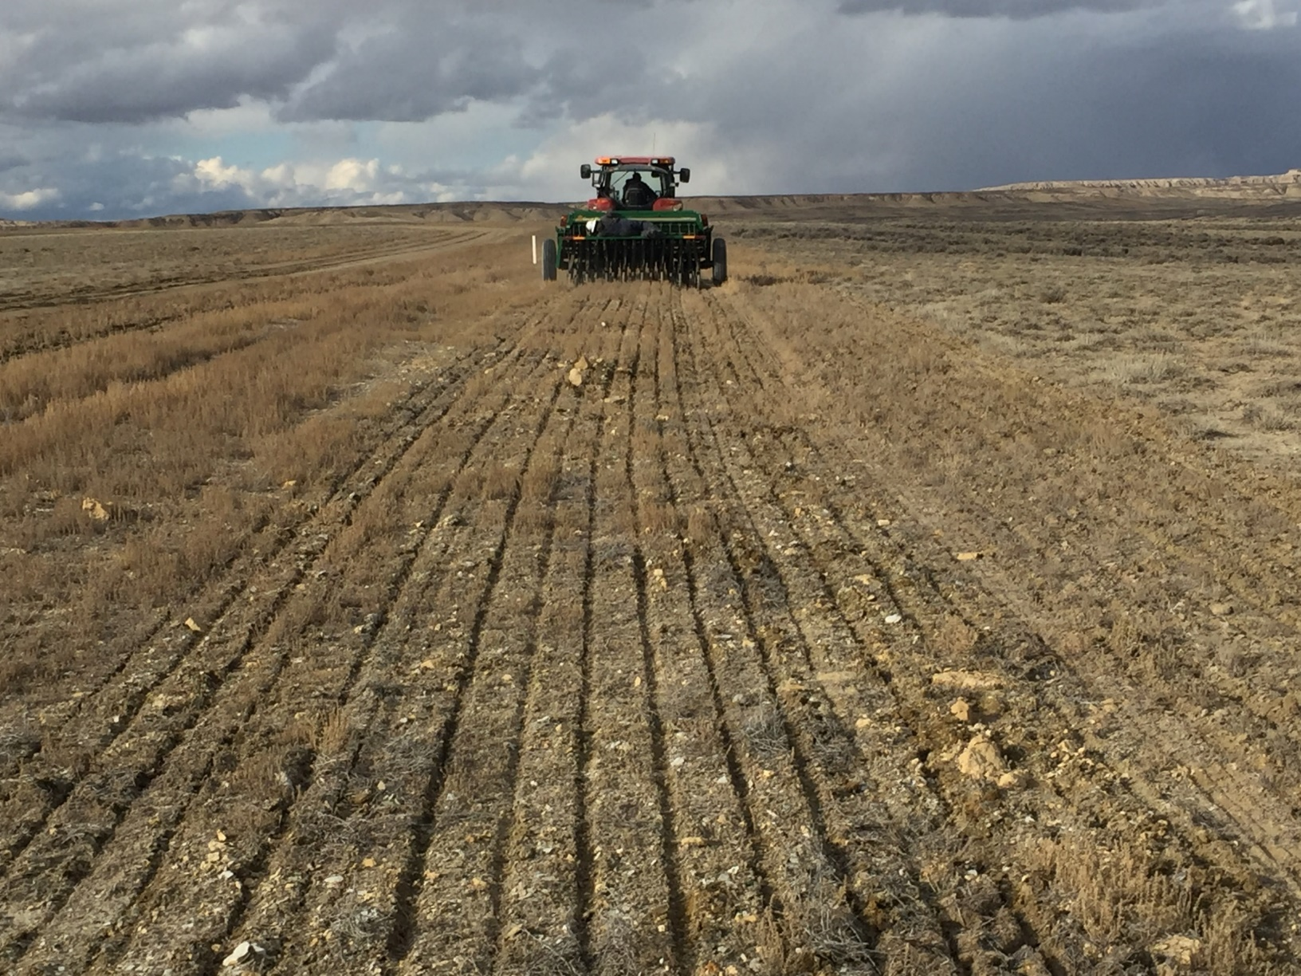
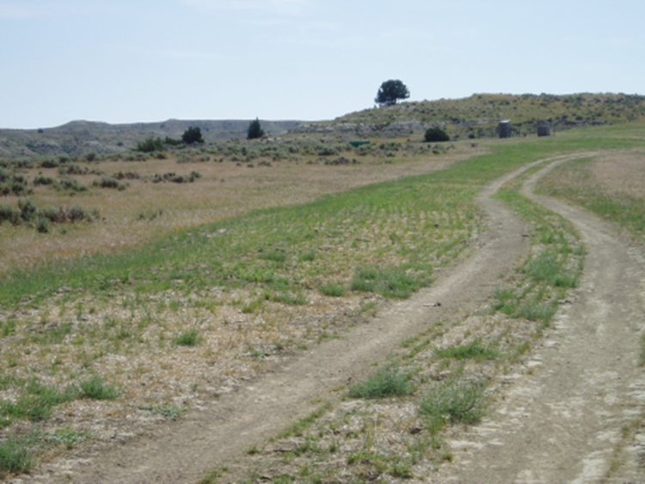
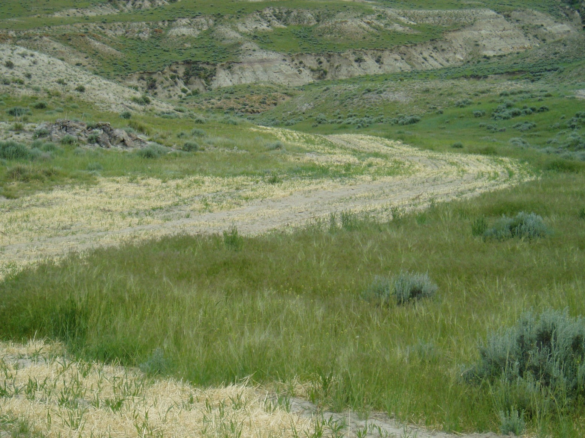
Minimizing Footprint to Maximize Success
Notes:
Once our development is approved – we look for ways to continue to reduce our footprint. These photos show a corridor to a well – this is the road, power (underground) and water and gas lines all in one. The entire disturbance is then reseeded and just a two track remains for the well access.

Slide 10
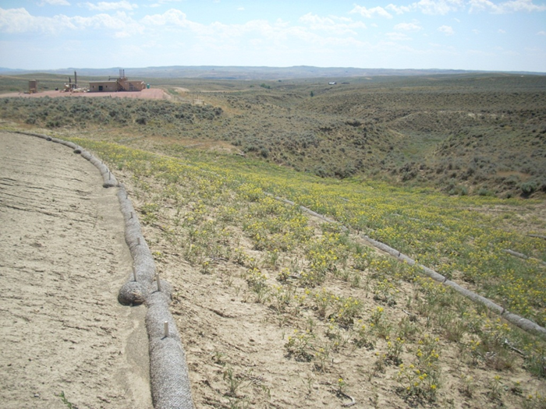
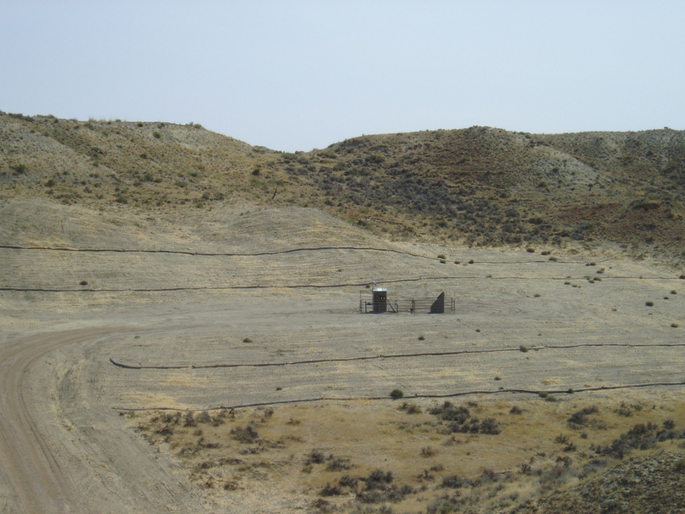
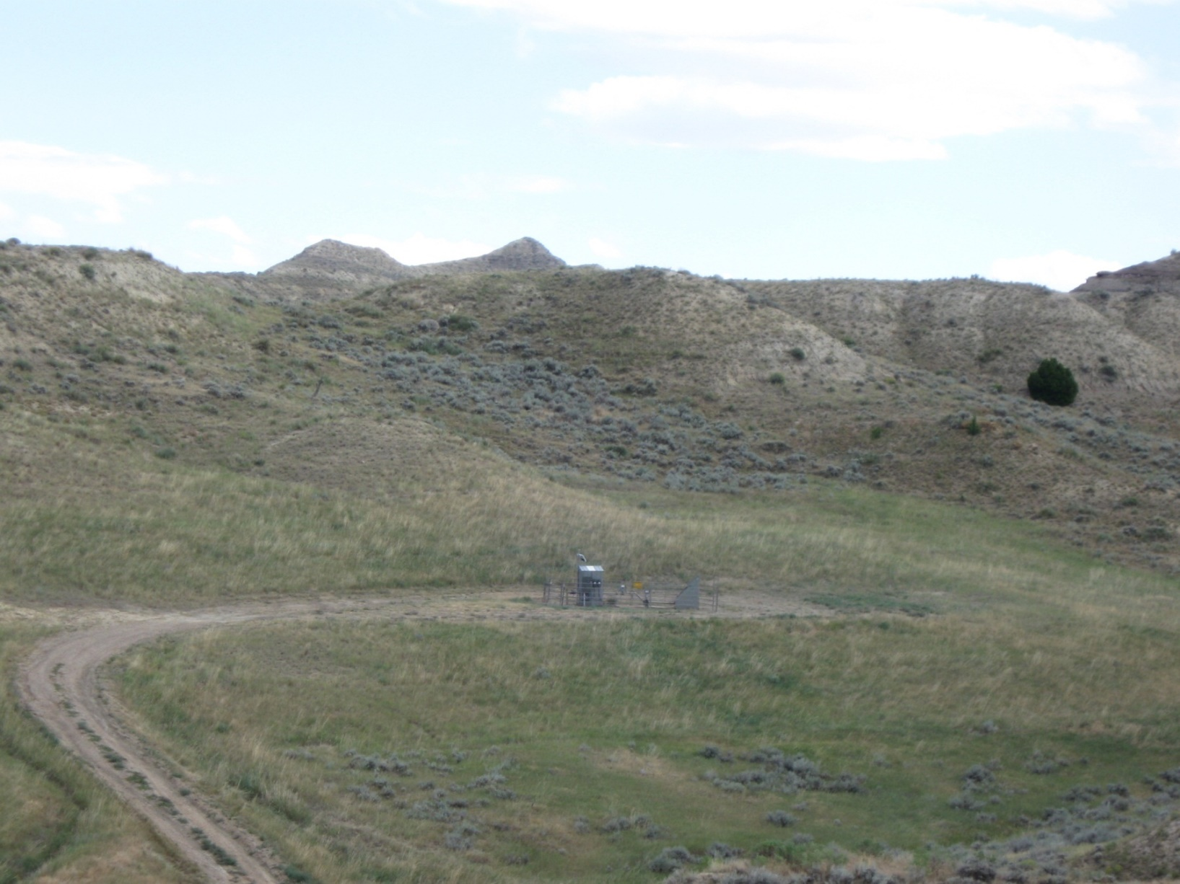
Reclamation: The Best Defense is a Good Offense
Notes:
Note the successful interim reclamation leaving only a small area unreclaimed for the life of the well production. By reclaiming quickly – there is little opportunity for weeds to become established, the desirable (in this case native) vegetation will keep weed problems to a minimum.

Slide 11
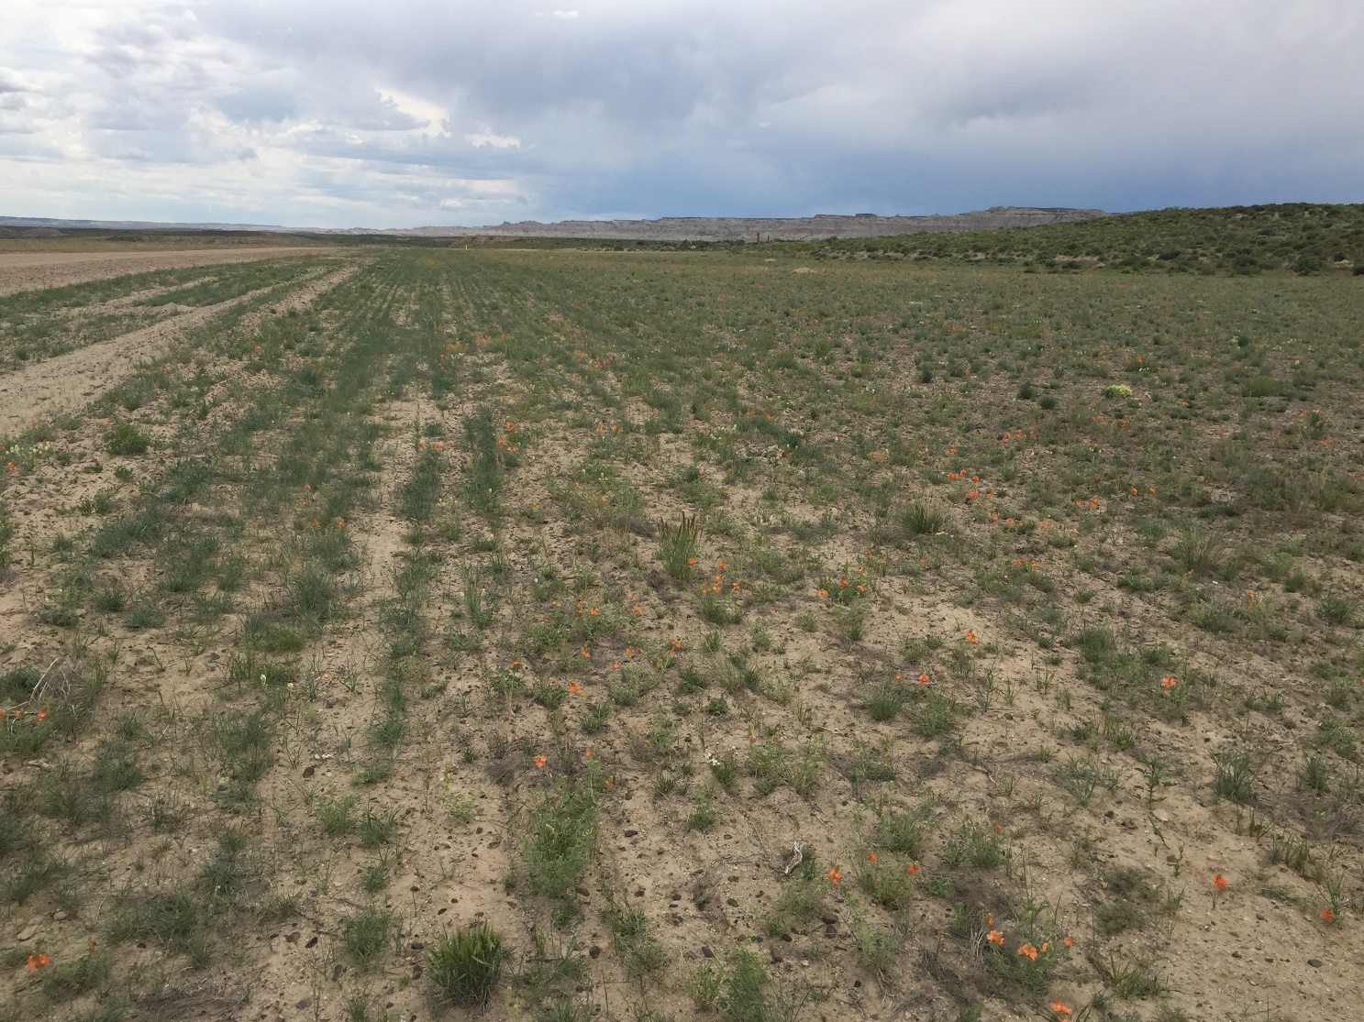
Reclamation: The Best Defense is a Good Offense

Slide 12
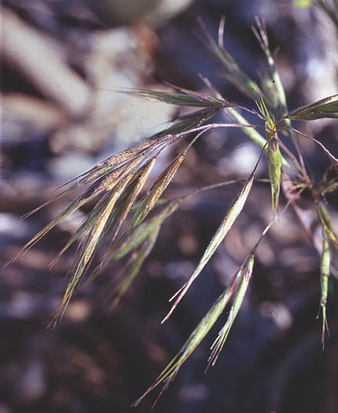
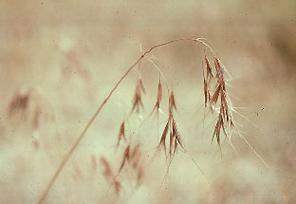
Look For “Clean” Seed Mixes & Adapted Species
Certified Weed Free Seed
Seed Certification/Analysis Sheets
Reduce/Eliminate Weedy Bromes
Use field data to identify successful and competitive plant species.
Notes:
While all seed is certified weed free, we also strive to use mixes with little to no cheat grass (which has become a large problem in the Powder River Basin).

Slide 13
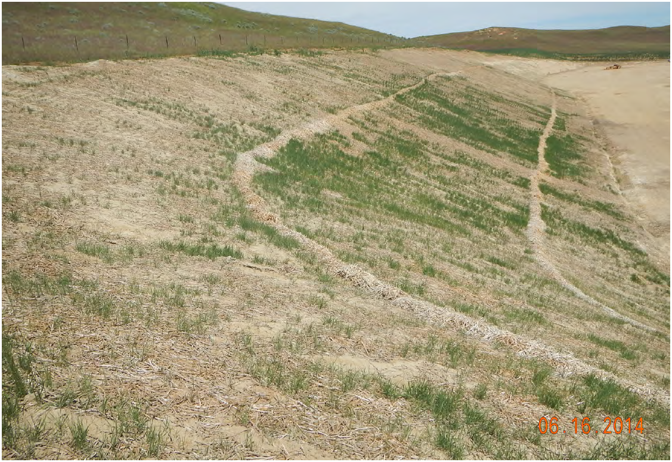
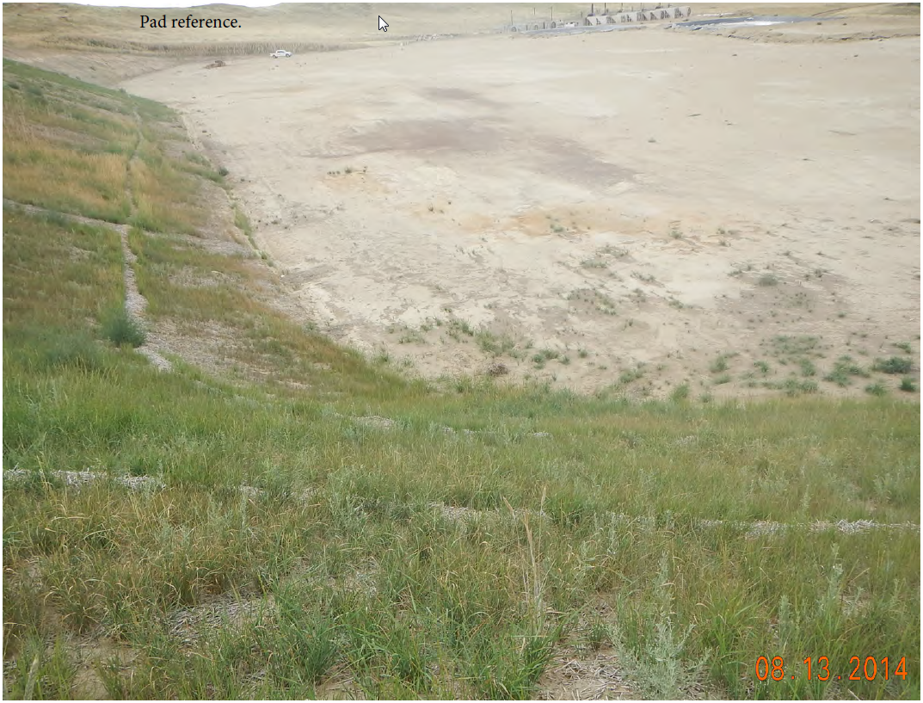
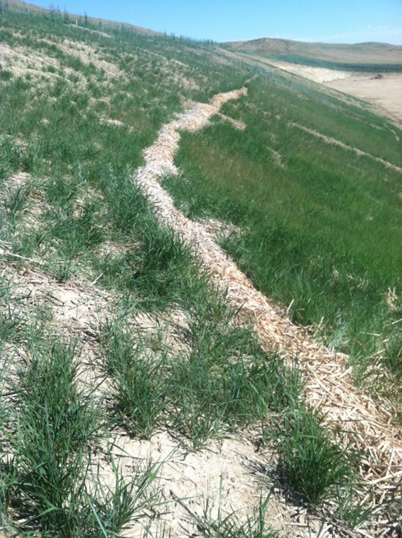
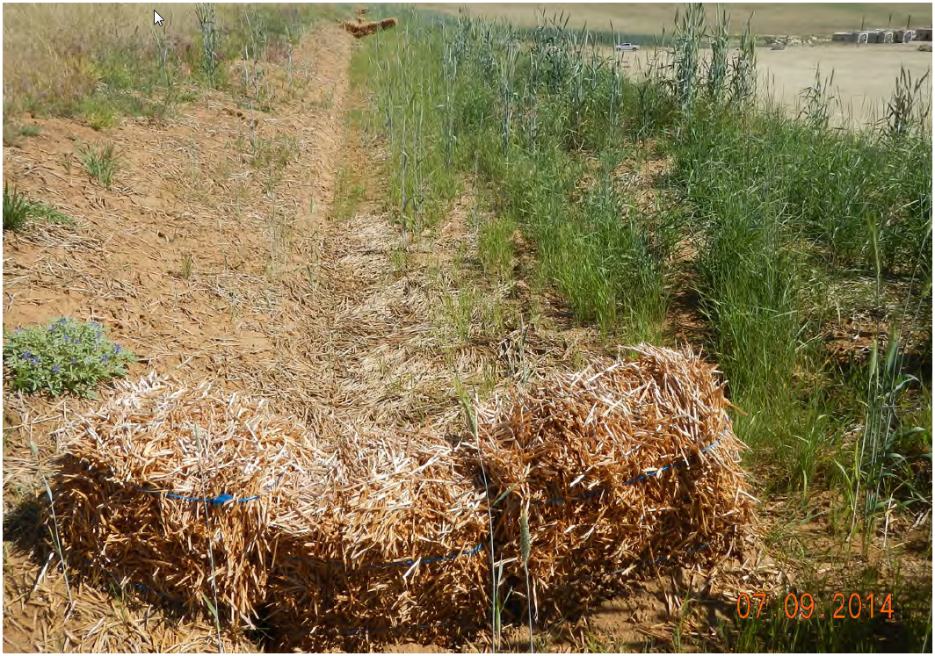
Quick Stabilization is Key to Success
Notes:
Shows how quickly a very steep site can be stabilized. This location has not been drilled yet, however the stabilization and temporary seeding is already in place to protect the fragile soils.

Slide 14
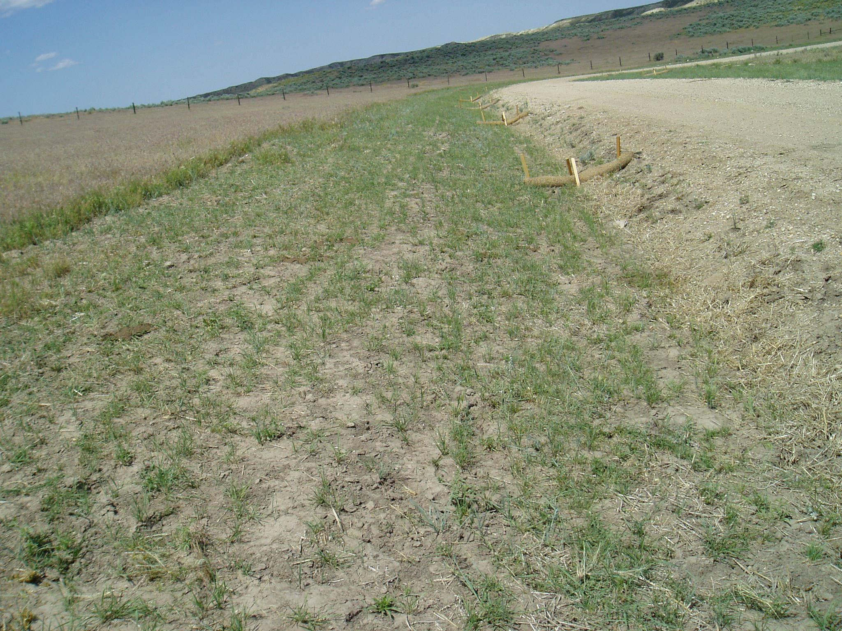
Quick Stabilization is Key to Success
Notes:
Note the native vegetation adjacent to a heavily cheat grass infested pasture – sometimes it’s an uphill battle but every little bit of successful reclamation helps.

Slide 15
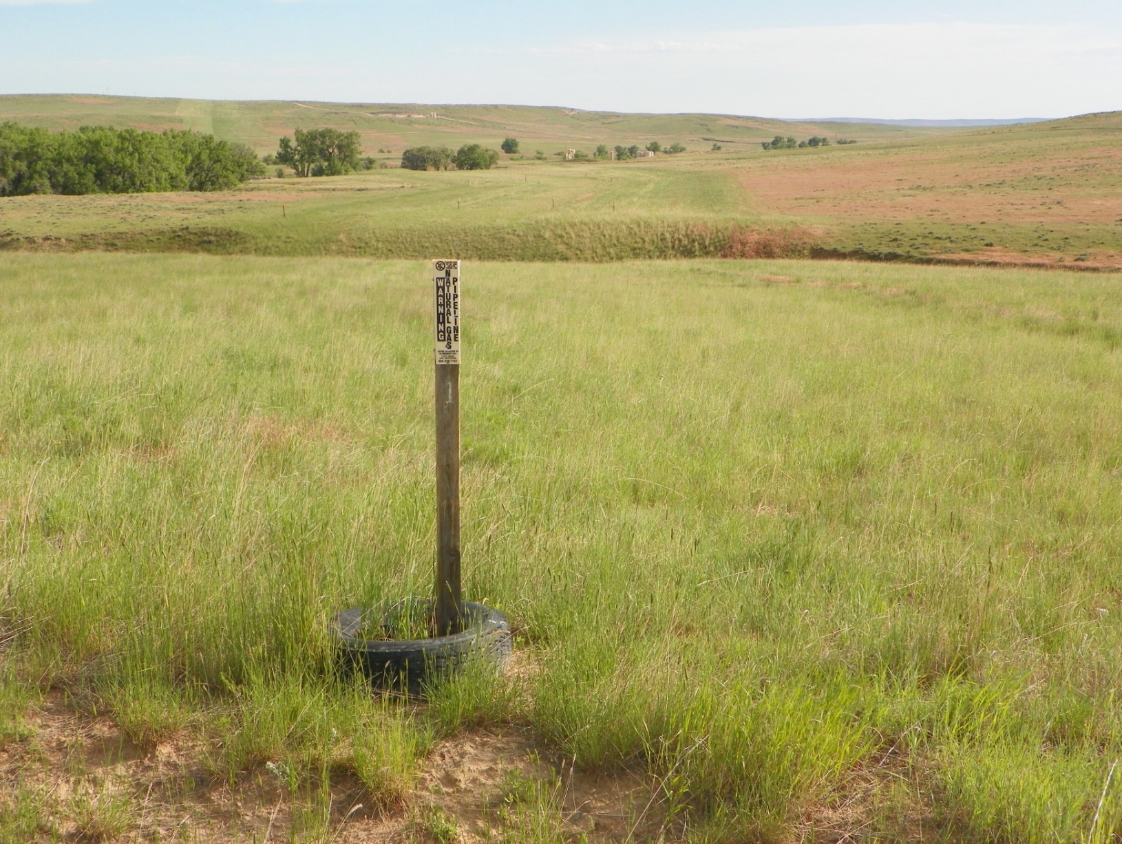
Quick Stabilization is Key to Success

Slide 16
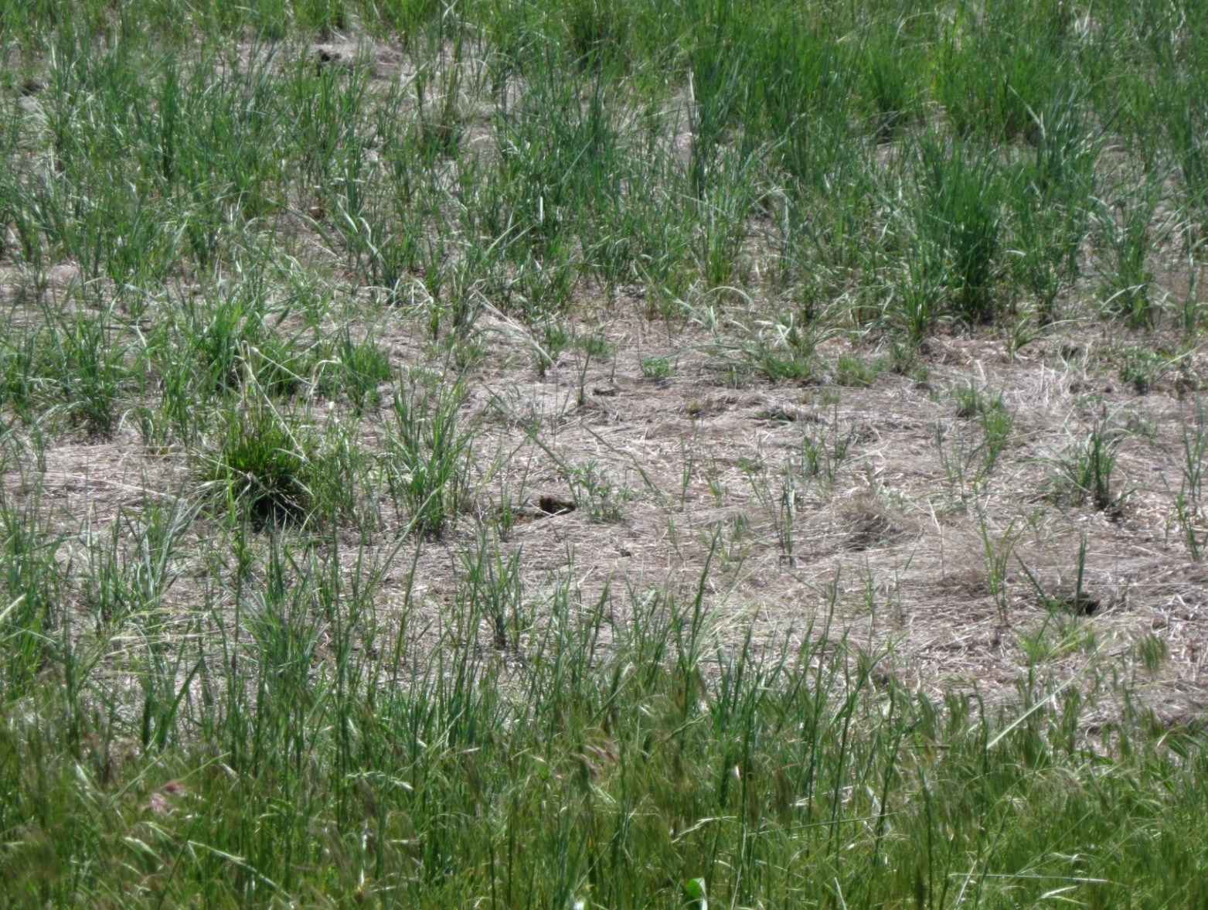
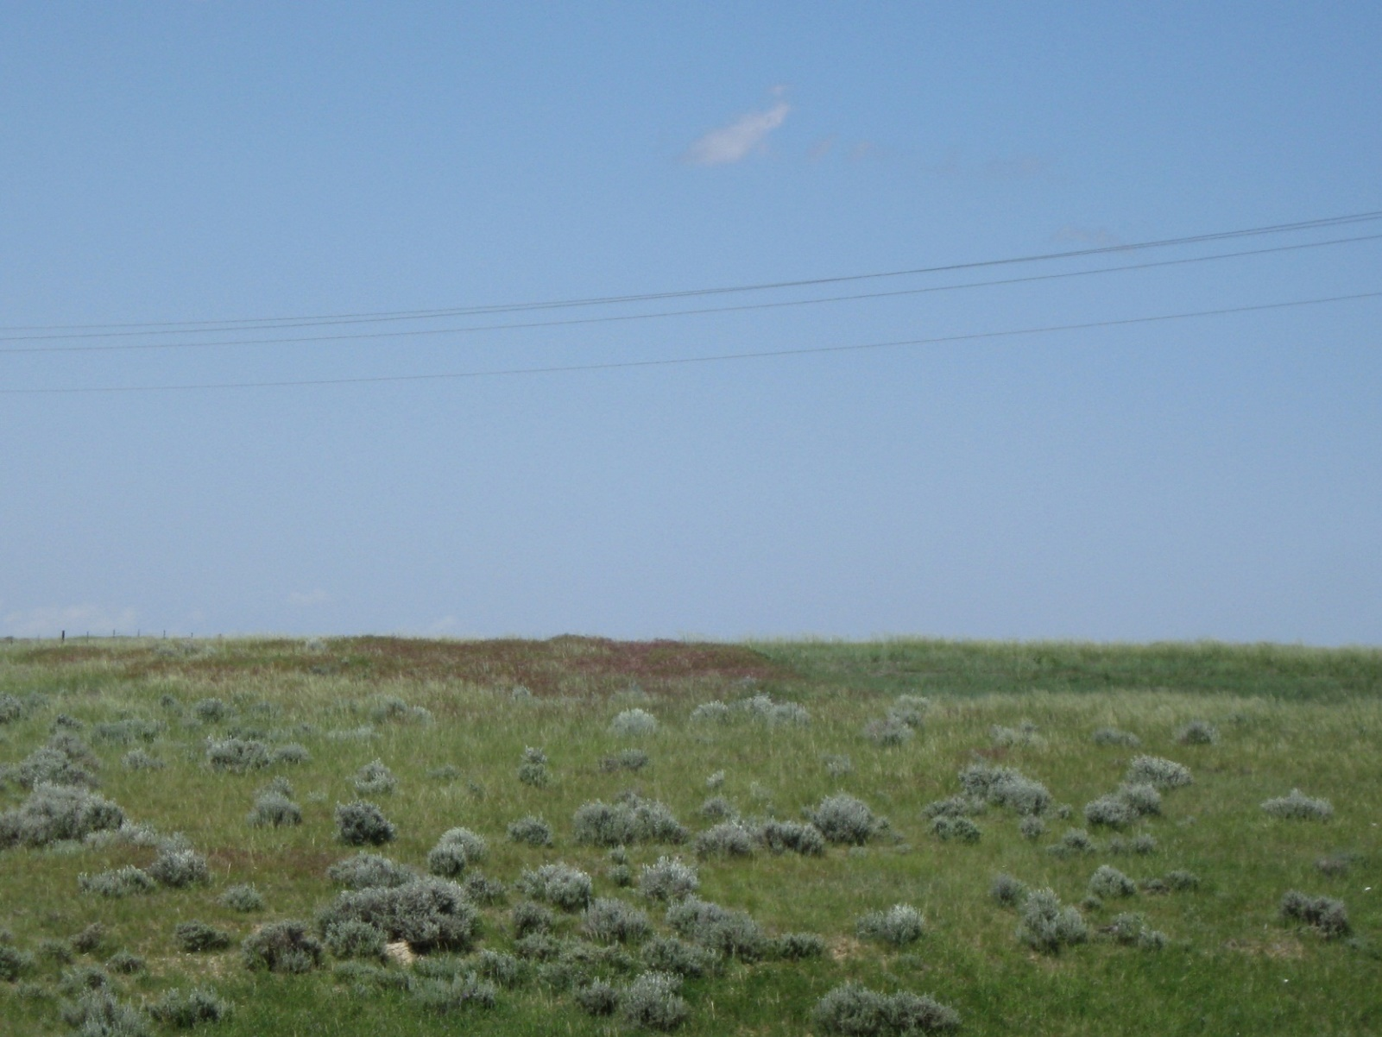
Invasive Species Management
Notes:
Next few slides will discuss some weed treatments and management practices. Cheat grass treatment – left side – untreated, right side treated. This was conducted around a sage grouse lek to enhance habitat.

Slide 17
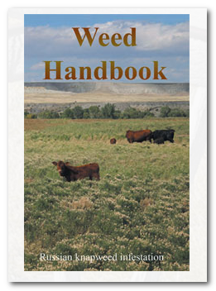
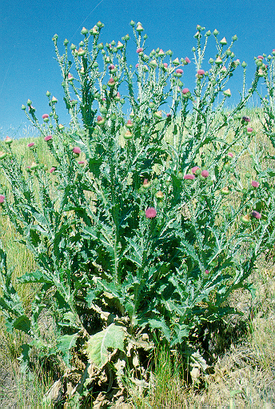
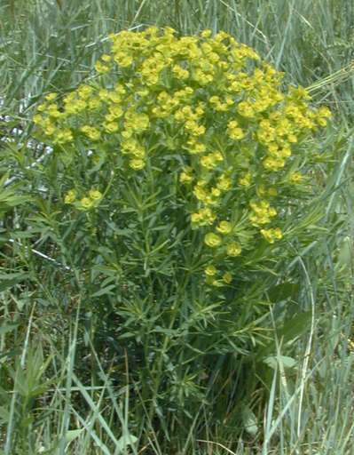
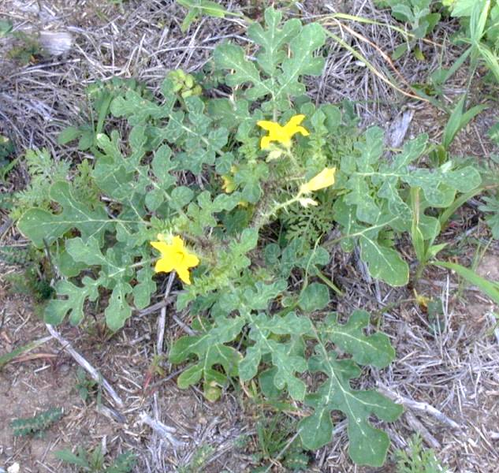

Understand the Problem
Annual – rely upon seed for reproduction, plant lives to reproduce (1 Season)
Biennial – 2 season life span, 1st season immature rosette, 2nd season bolt & flower
Perennial – Living longer than one season
Notes:
It’s important to provide our field employees with some weed id training. This training helps identify weed issues in the field – it’s like having 300 weed managers in the field every day! Employees are provided a weed ID handbook.

Slide 18

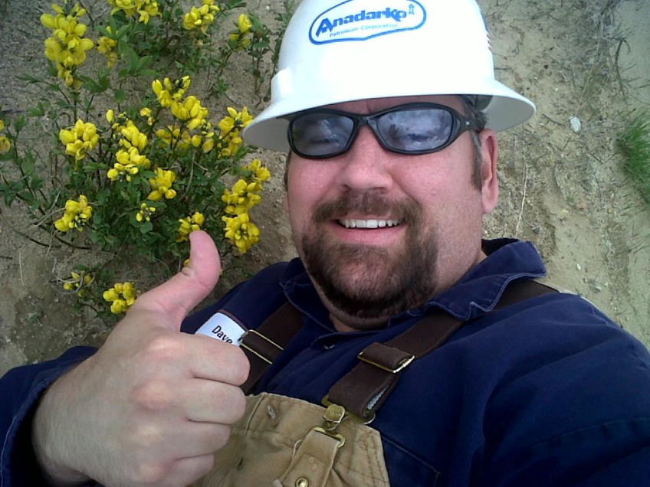
Use an Integrated Approach
FOR WEED MANAGEMENT TO BE THE MOST SUCCESSFUL, AN INTEGRATED APPROACH SHOULD BE UTILIZED.
THE STEPS INCLUDE
  Identify the weed species to be controlled
  Map the infestations
  Create a plan
  Follow through

Slide 19
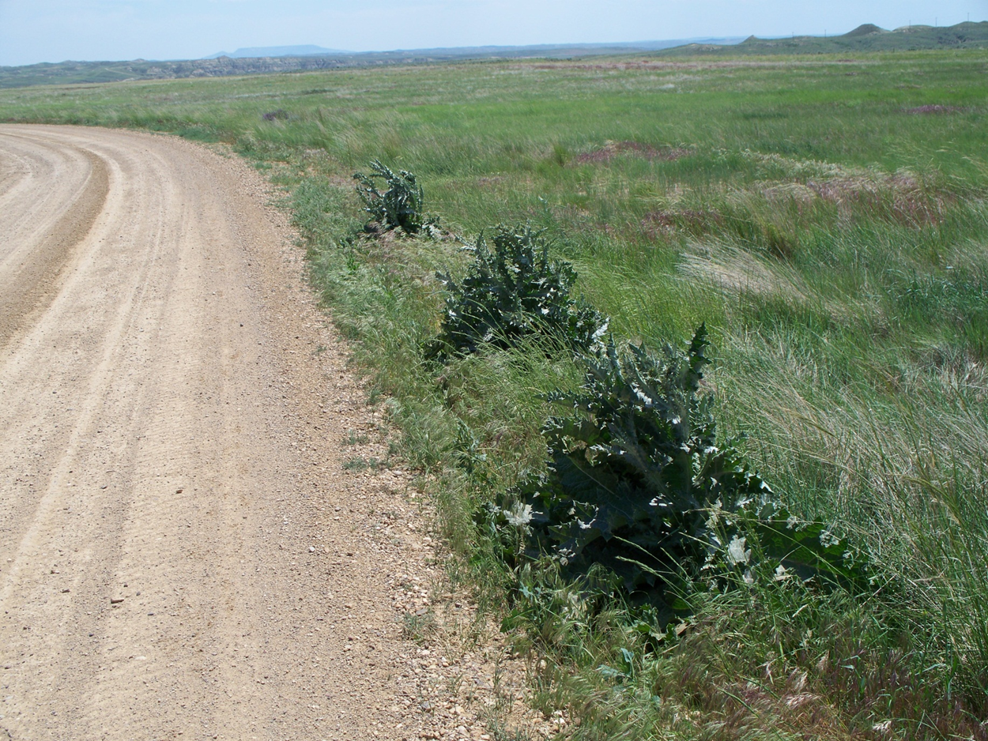
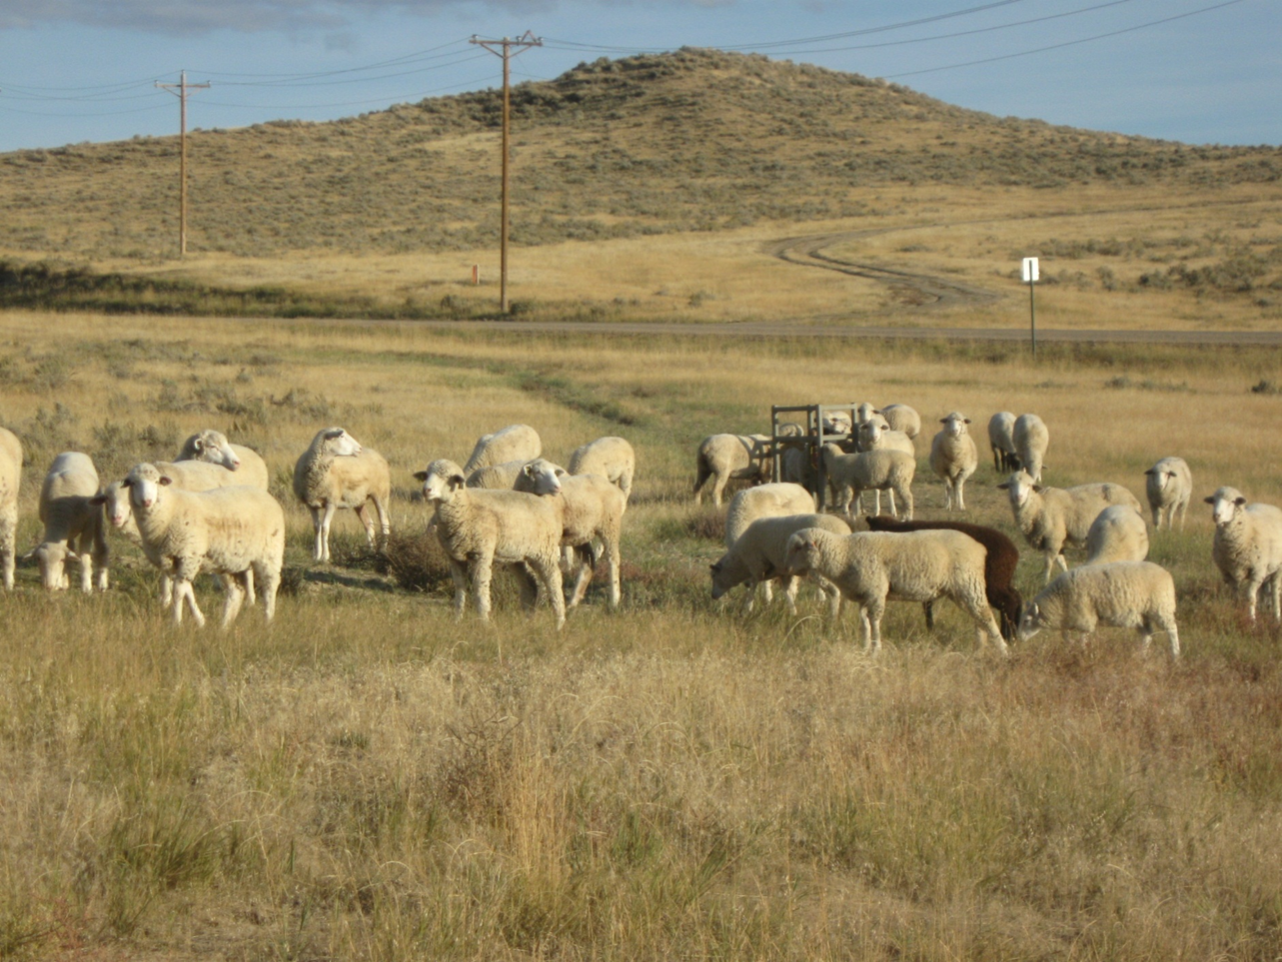
Challenges Come in Many Shapes & Sizes
Notes:
For weed management in oil and gas – there are always challenges – certain areas require more monitoring than others – such as roadways that can be corridors for weed seeds. Livestock can also cause pressure on newly reclaimed areas – such as is shown here on this newly establishing pipeline and they can also transport weeds from place to place.

Slide 20
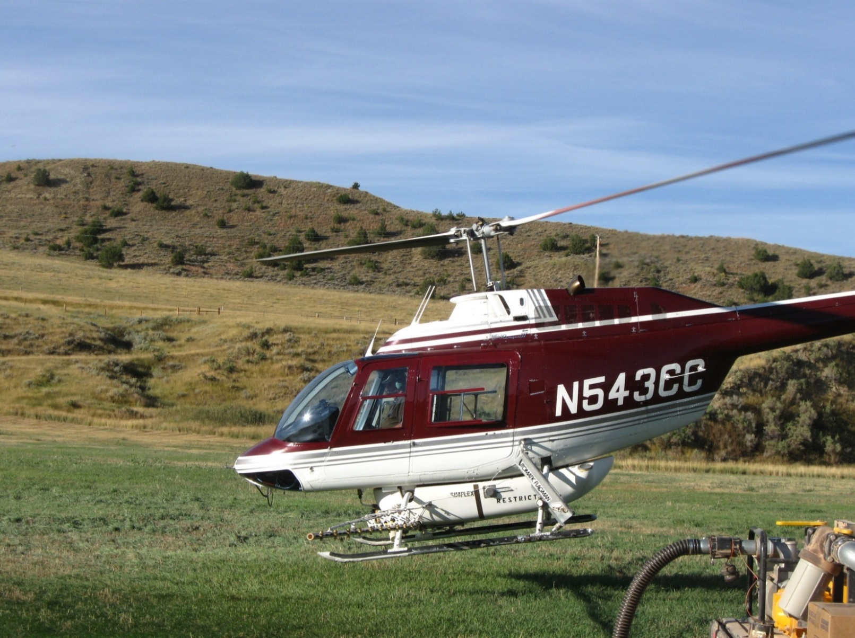
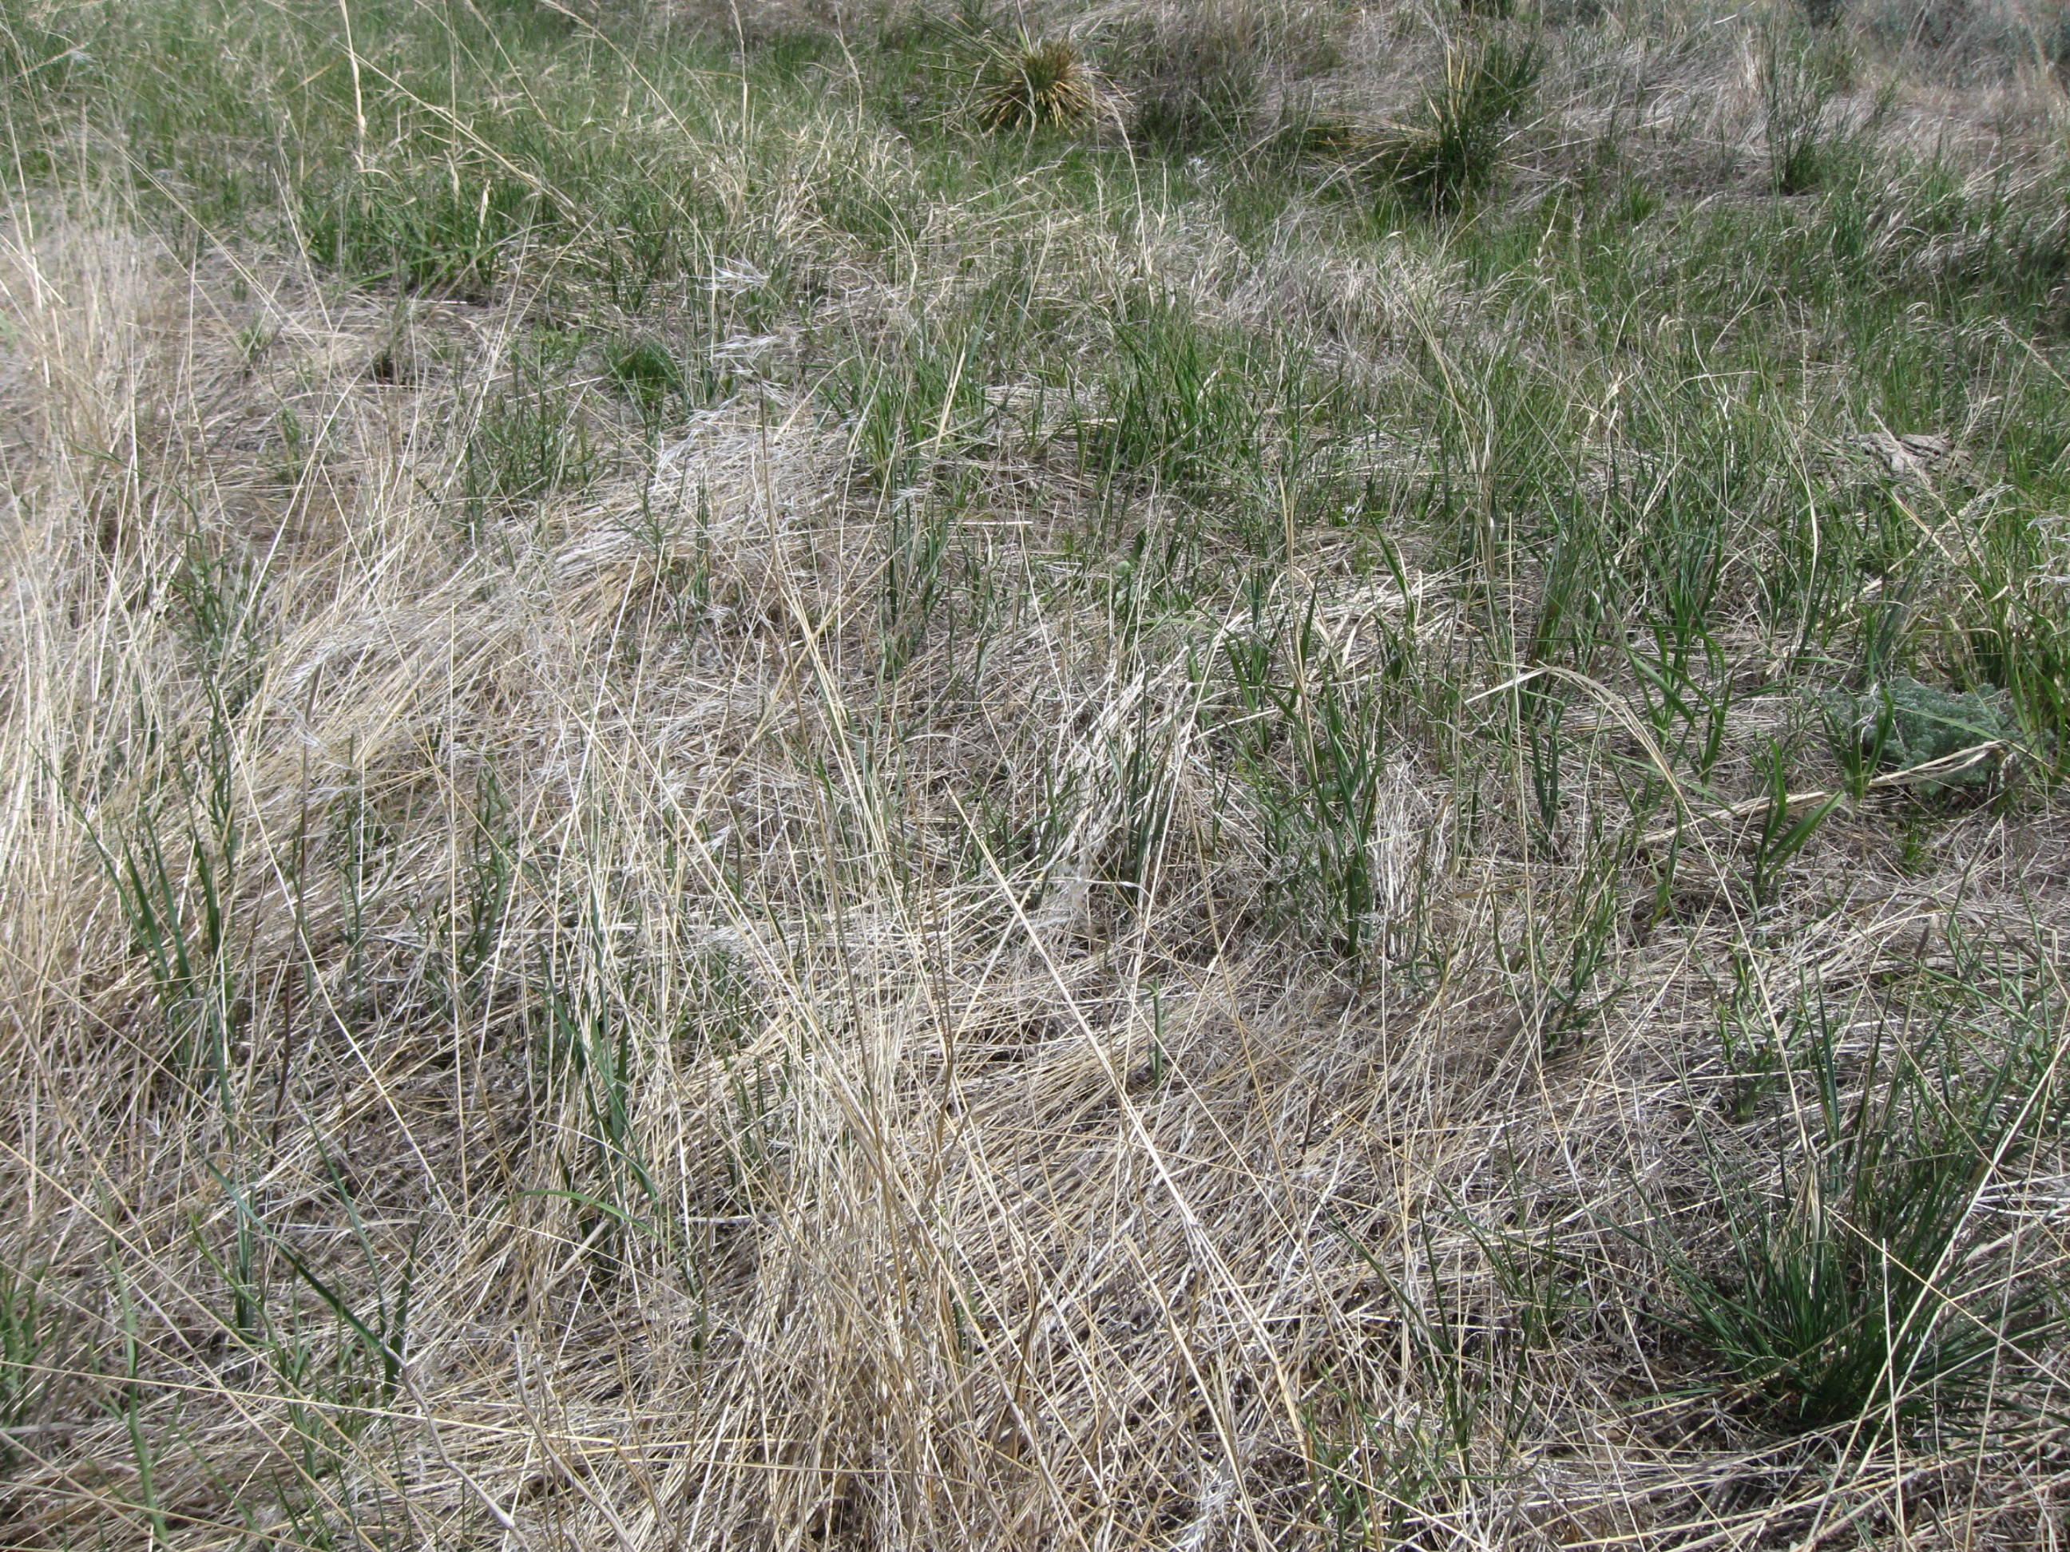
Take a Look at the Big Picture
Notes:
Anadarko has treated over 10,000 acres in the Fortification Creek Special Management Area – to provide enhanced habitat for the local elk herd and sage grouse while developing natural gas in the management area.

Slide 21
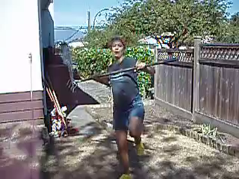
Invasive Species Control is Tricky Business

Slide 22
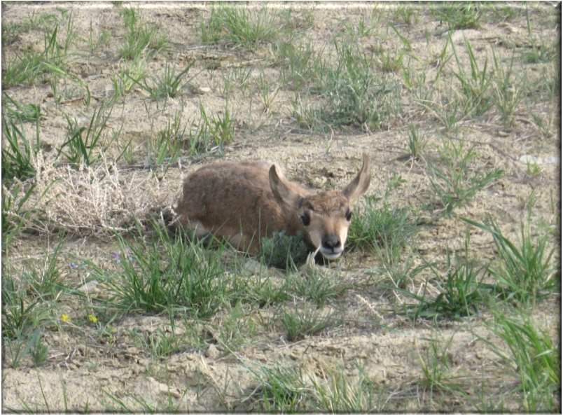
QUESTIONS?

